Slide 1
Benchmarking
Jon Gamble
Head of Intermediaries
September 2018

Slide 2

Tomorrow’s benchmark…
Best practice today is tomorrow’s benchmark,
is the day after tomorrow’s regulatory requirement….

Slide 3

Asset Risk Consultants?
established in 1995 and since 2002 ARC has been an independent, privately-owned firm
with a team of c.60 staff, ARC operates from offices in London, Guernsey & Jersey
provides investment consulting & research services to an international client base
has a history of innovation, introducing a steady stream of industry initiatives

Slide 4
Options available…
Market Indices / Tracker Funds
Peer Groups / Sectors
Inflation / Cash
Your Expectations

Slide 5
A persistent problem…

Slide 6
A persistent problem…
What do I do when average is “bad”?

Slide 7
When considering risk…

Slide 8
When considering risk…
Is half the risk for 60% of the return reasonable?

Slide 9
Options available…
Market Indices / Tracker Funds
Peer Groups / Sectors
Inflation / Cash
Your Expectations
measureable and unambiguous

Slide 10



Back to school

Slide 11
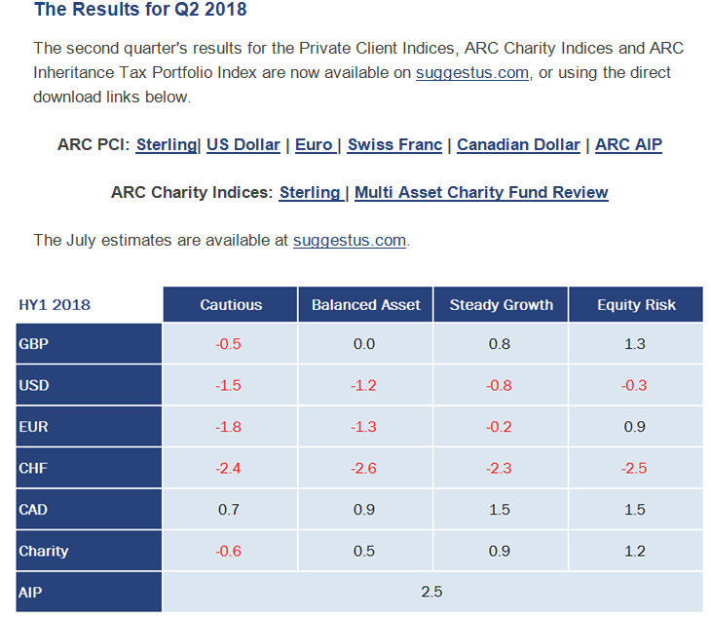

A valid indicator?
80+ Investment Managers
150,000+ real portfolios

Slide 12
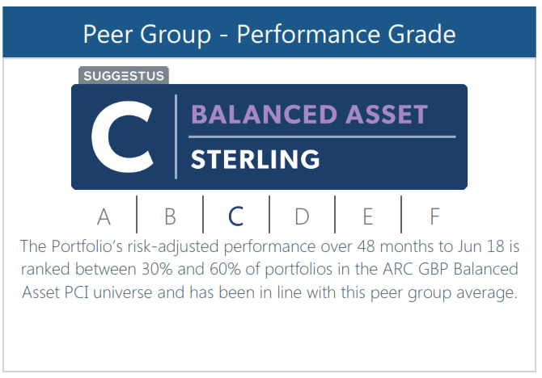
What’s my grade?

Slide 13
Options available…
Market Indices / Tracker Funds
Peer Groups / Sectors
Inflation / Cash
Your Expectations
relevant and reflective

Slide 14
Setting my investment goals?

Slide 15
My long term investment goals…

Slide 16
Cash versus Inflation…

Slide 17
Options available…
Market Indices / Tracker Funds
Peer Groups / Sectors
Inflation / Cash
Your Expectations
aligned and specified

Slide 18
Options available…
Market Indices / Tracker Funds
Peer Groups / Sectors
Inflation / Cash
Your Expectations

Slide 19
Options available…
Market Indices / Tracker Funds
Peer Groups / Sectors
Inflation / Cash
Your Expectations
Context

Slide 20
Benchmarking
Combined, these indicators provide context required for review

Slide 21
Portfolio evaluation
  How has the portfolio performed?
  What risks have been taken?
  How good has trade-off been?
  Other qualitative matters?
  Actions to be considered?

Slide 22
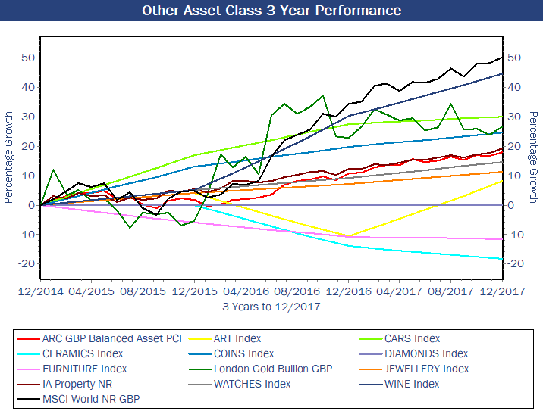
What about other assets?

Slide 23
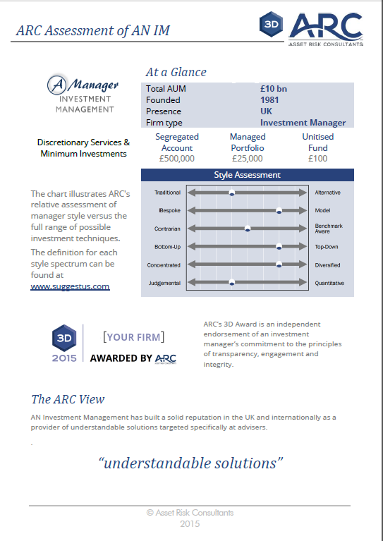
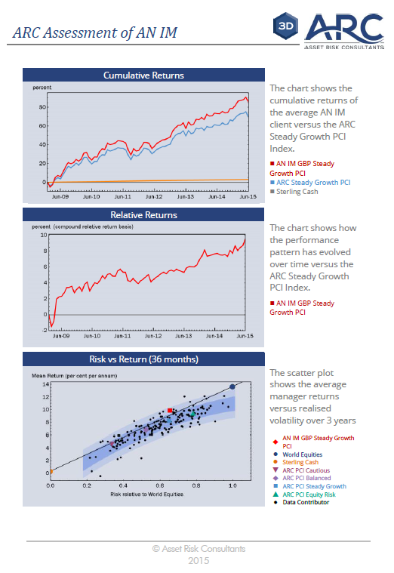
An investment manager report…

Slide 24


Portfolio specific returns

Slide 25

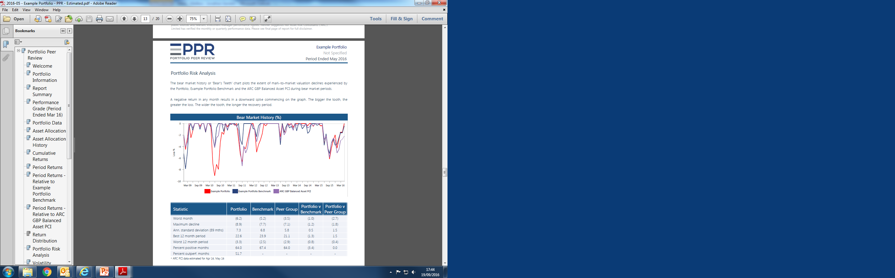


Portfolio specific risks

Slide 26
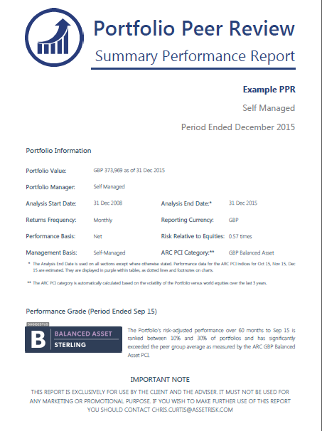
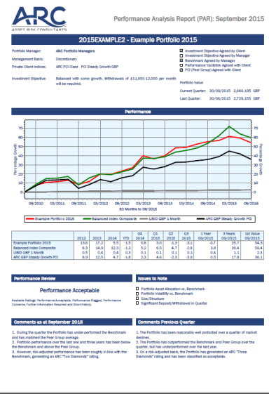
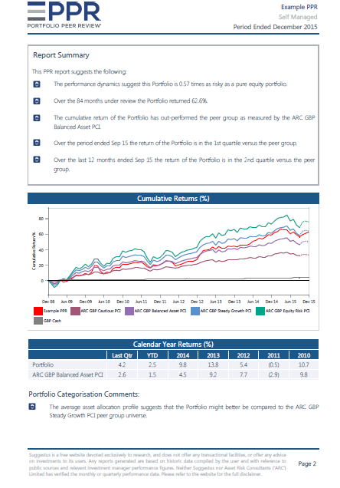
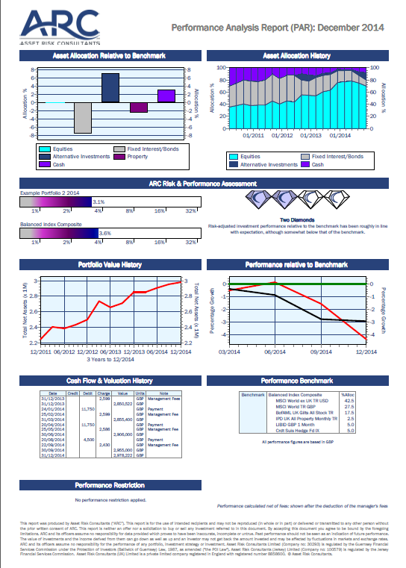
Efficient Performance Reporting
Reporting | Use PCIs | Portfolio Peer Review | Independent Third Party Analysis & Review
Input | Figures from Manager or Suggestus | You/Manager input data and select comparators | Portfolio data loaded independently
Output | Single period snapshot | Report with analysis | Report with analysis and guidance

Slide 27
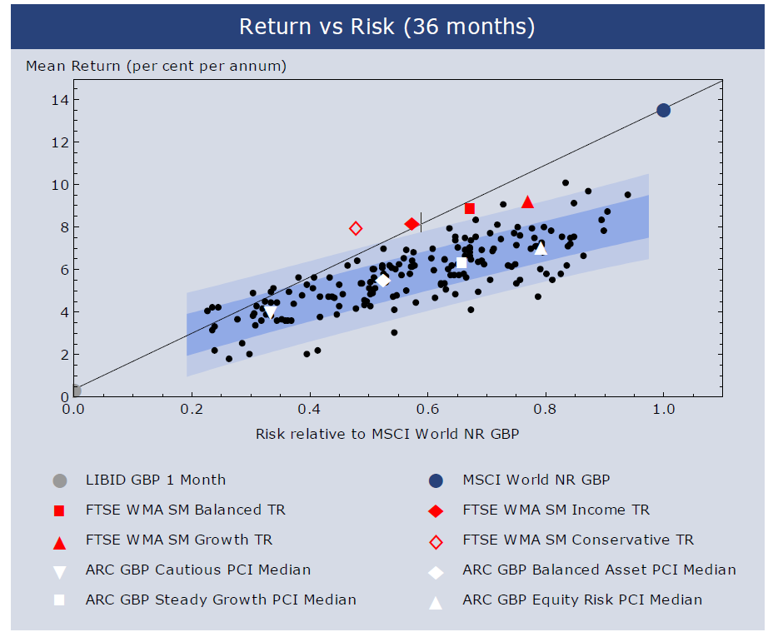
Persistent Benchmark Problem

Slide 28
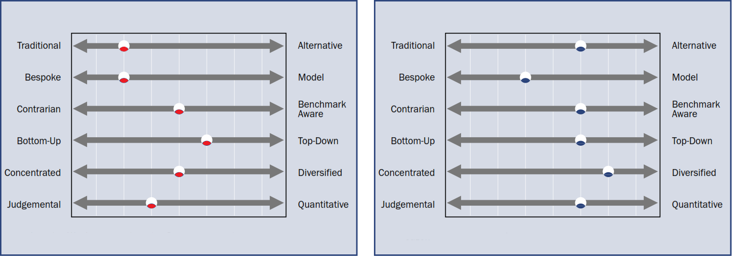
Two managers in town
Manager Red
Manager Blue

Slide 29
Manager Style Assessment
The asset mix utilized by the manager
Traditional vs. Alternative
Asset Class Blend
The range of underlying investments within each asset class that should be held within a portfolio
Diversified vs. Concentrated
The degree to which portfolio managers are able to express their own opinions when constructing client portfolios
Significant vs. Minimal
Bespoke vs. Model
Investment Diversity
Portfolio Manager Discretion
MANAGER STYLE
The primary driver in the manager’s decision making process
Judgemental vs. Quantitative
Decision Making Input
Points of Reference
The degree to which portfolio performance should be correlated with a particular benchmark
Benchmark Aware vs. Contrarian
Investment Approach
The viewpoint from which the manager decides asset allocation and investment selection
Top-down vs. Bottom-up

Slide 30


























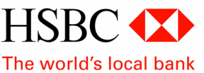














Pitfalls: The world is full of choice...
ARC collates information and works with all investment managers
ARC does not operate a preferred manager list

Slide 31
Conclusion
Place performance into context through multiple measures
Supplement performance with risk analysis
Aim to understand drivers of returns and manager style
Apply through a repeatable monitoring process

Slide 32
Questions?
?

Slide 33

Jonathan Gamble
Director & Head of Intermediaries
Jonathan joined ARC in 2001. Jonathan has been key in developing relationships with intermediaries, advising on and reviewing investment portfolios of Intermediaries (Trustees, Lawyers, Accountants, larger IFA networks and Wealth Managers). These portfolios consist of both discretionary managed portfolios as well as those of a more advisory nature. In addition, he has over eight years’ experience as Non-Executive Director on a number of AIM and London listed investment companies.
Following an Economics degree from the London School of Economics, Jonathan joined Morgan Stanley International in London, trading foreign exchange. Two years later he moved to Sydney where he worked for Société Générale, being promoted to SG’s Regional Chief Dealer in Singapore. After moving to Paris, he attended INSEAD. On completing his MBA (Distinction), Jonathan launched an electronic derivative-trading platform with venture capital backing. He joined ARC, when he returned to Guernsey with his wife and two children.
Contact:
Tel: +44 (0) 1481 817778
Mobile: +44 (0) 7911 766671
Email: jonathan.gamble@assetrisk.com

Slide 34
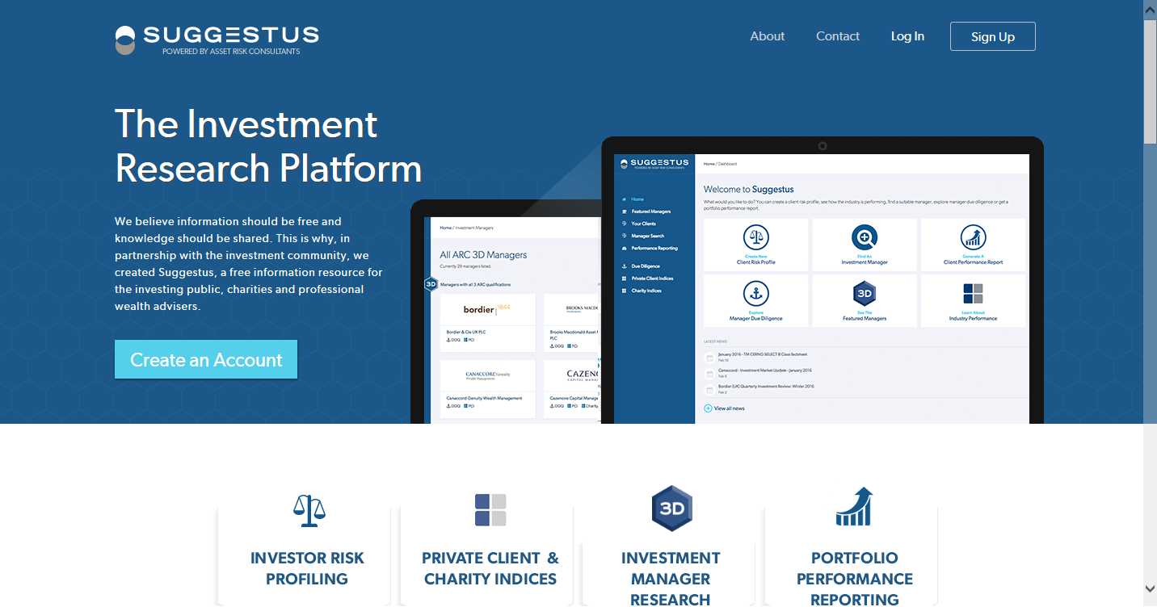
Direct access…

Slide 35
Disclaimer
This presentation was produced by Asset Risk Consultants (“ARC”) and is for the use of intended recipients and may not be reproduced (in whole or in part) or delivered or transmitted to any other person without the prior written consent of ARC. This presentation is neither an offer nor a solicitation to buy or sell any investment referred to in this document. This presentation does not amount to investment advice. By accepting this document you agree to be bound by the foregoing limitations.
Any advice or recommendation rendered by us to you or the results of any research carried out on your behalf is provided solely for the purpose of this engagement and for your benefit. ARC does not accept any liability whatsoever for any direct or consequential loss arising from any use of material contained in this presentation. All estimates and opinions included in this presentation constitute our judgements as of the date of this presentation. The views expressed in conjunction with this presentation are those of the contributor at the time of the presentation.
Past performance should not be seen as an indication of future performance. The value of investments and the income derived from them can go down as well as up and an investor may not get back the amount invested and may be affected by fluctuations in markets and exchange rates. The price history utilised in the analysis was supplied by Lipper, a Thomson Reuters Company and other data sources. All reasonable precautions have been taken to ensure the accuracy of the information provided but no assurances or warranties are given.
Asset Risk Consultants Limited is authorised and regulated by the Guernsey Financial Services Commission (ref 92296).
Asset Risk Consultants (UK) Limited is authorised and regulated by the Financial Conduct Authority (ref 652972).
Asset Risk Consultants (Jersey) Limited is authorised and regulated by the Jersey Financial Services Commission (IB0257).
Copyright Asset Risk Consultants Limited 2018.

