Slide 1
SSAS/SIPP planning opportunities
Sheffield Life & Pensions
Society
22 January 2019
Stephen McPhillips BA, FPMI
Technical Sales Director
Notes:
Good Morning and introduction to speaker and very briefly to Dentons

Slide 2
Agenda.
Introduction to Dentons
SSAS /SIPP Comparison
Joint Property ownership
SSAS fund allocation calculations

Slide 3
An introduction to Dentons.
Bespoke SIPP and SSAS provider
Established over 40 years
Continuity of staff
Long history of profitability
6300 SIPPs
786 SSASs
AUA £4.7bn
2600 commercial properties
Notes:
Read slide, Focus on:
Bespoke player in the market, experts in Commercial Property and non-standard investments. Provide tailored services for the market segments that the big providers don’t serve well. (AJ Bell, James Hay, Curtis Banks)
Longevity and experience of staff. Pension Consultants over 20/25 years with the company. Ian and Derrick (Joint MD and Senior Pension Consultants) sit on the board. Admin 10 years +
In profit and more than meet Capital Adequacy requirements.
Average SIPP £530+m SSAS £1.4m, over nearly 2600 properties held in our schemes.

Slide 4
SSAS.
Structure

Slide 5
SIPP.
Member Trustee
Denton & Co Trustees Ltd
Bank Account
ASSET 1
ASSET 2
ASSET 3
Financial Adviser
Dentons Pension Management Ltd
Notes:
Explain the common master trust – sub trust structure and the roles of the relevant parties using Dentons structure as an example:
Explain the inclusion of the Financial Adviser as no advice offered by SIPP provider.

Slide 6
SSAS.
Employer
Member Trustee 1
Denton & Co Trustees Ltd
BANK ACCOUNT
Member Trustee 2
ASSET 1
ASSET 2
ASSET 3
Dentons Pension Management Ltd
Member Trustee 3
Accountant
Financial Adviser

Slide 7
SSAS.
Structure
Regulation
Investment

Slide 8
SSAS Investment.
Loan back criteria: The magic five
Maximum amount: 50% of net scheme assets
Repayments: Capital & interest
Loan term: 5 years
Interest rates: 1% above “base” and commercial
Security: First charge
Sponsoring Employer shares
Taxable property rules: Owning and controlling a trading entity

Slide 9
Loan Security Options.
Commercial Property
Residential Property*
Plant and machinery*
Book Debt*
Company Shares*

Slide 10
SSAS.
Structure
Regulation
Investment
Allocations/Earmarking
Costs
Control
Establishment

Slide 11
SSAS Registration Timescales.
Document completion
Initial online submission
APSS 530
Reply
Wait
Formal registration

Slide 12
SSAS Advantages over SIPPs.
Pooling of assets
Cascading of assets
Economies of scale
Lighter Regulatory touch?
Less investment restriction?

Slide 13
Asset transfer: SSAS.
Property
Generation 1
Generation 1
Generation 2
Generation 2
Notes:
Family business – SSAS with property fund built up by parents –generation 1
Explain how new contributions in are used to pay benefits for generation 1 and as a result in return the allocation of the property is gradually transferred to generation 2

Slide 14
Asset transfer: SIPP.
PROPERTY
SIPP Generation 1
SIPP Generation 1
SIPP Generation 2
SIPP Generation 2
Notes:
Same situation of family business with individual SIPPs
Can do exactly the same BUT moneys need to be physically moved from SIPP to SIPP and property is actually conveyed from SIPP to SIPP. Once SDLT threshold is reached, SDLT could be payable as the underlying beneficial ownership could change.

Slide 15
Commercial Property.
Benefits
Pension scheme is a separate legal entity
Asset sits outside of member’s estate
Income tax exempt
Capital gains tax exempt
Tangible asset
Stable income stream
Release capital from SIPP to business for connected transactions
Disadvantages
Single large asset
Illiquidity
Consider CGT implications for business
Notes:
Run through slide

Slide 16
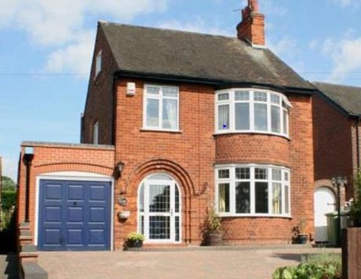
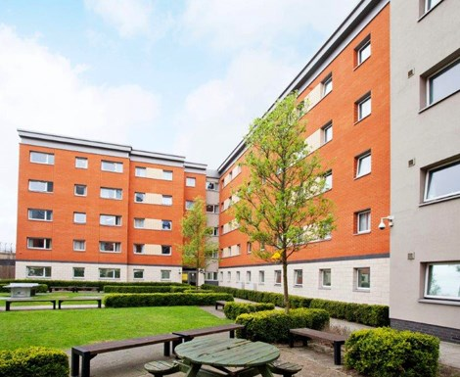
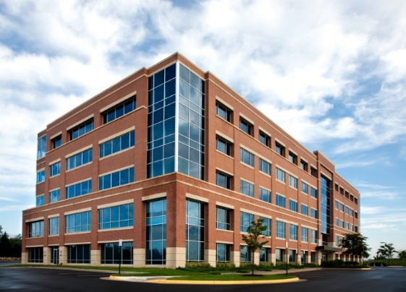
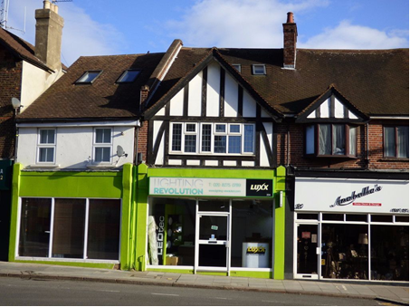
SIPP and SSAS: Acceptable properties?
Notes:
One: it’s a house – HMRC treat any property “capable” of residential as being so – explain tax charge arises.
Two: Bespoke halls of residence - we’d need to see floorplans etc. and it needs to be attached to a recognised place of learning – each one reviewed separately.
Three: Office block with multi- leases. Fine
Four: Shop with flat above: Explain cannot hold freehold if it includes even a reversionary interest – ways round so it can be held. Case study later.

Slide 17
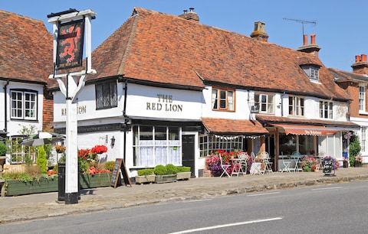
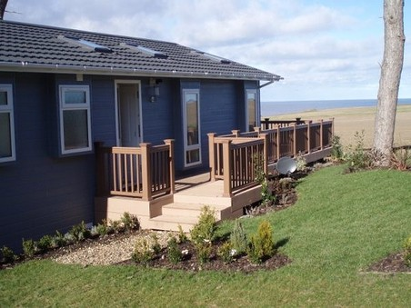
SIPP and SSAS: Acceptable properties?
Notes:
One: The Beatles, what we were looking for here was holding of intellectual property which can be held subject to valuation and individual assessment.
Two: It’s a pub with managers accommodation above it/letting rooms so as long as it meets lease criteria and employee occupation criteria it can be acceptable
Three: It’s a holiday let so irrespective of what its used for or tenancy agreement in place, HMRC will regard this as residential
Four: Agricultural – okay but needs to have a specific investment reason for acquisition and a tenant in place. We won’t entertain land banking. Warnings about proximity to member’s residence – separate title, separate boundary, separate access – ability to sell the land unfettered by residential neighbour.

Slide 18
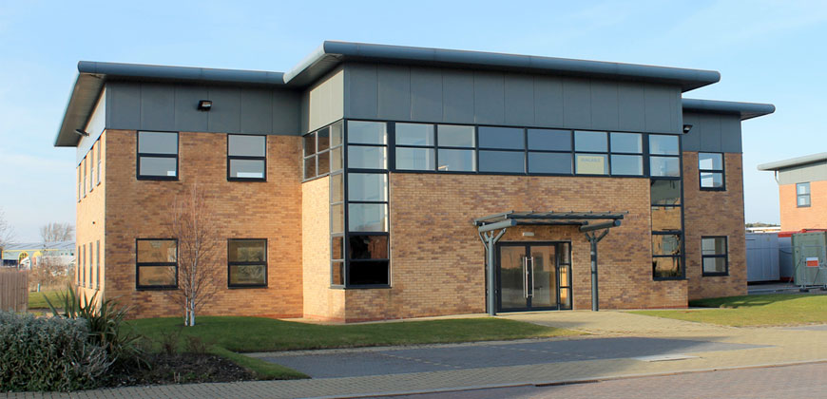
Property Purchase – A Case Study.
Transfer value: £200,000
50 % borrowing available
Available fund: £300,000
Property price: £670,000
No VAT applicable
SDLT: £23,000
Other costs: c.£7000
Required funds: £700,000
Notes:
Case Study – now moving on to the more complex
Explain figures on slide and that current pension fund and borrowing (buying power) is insufficient to acquire whole property at outset.
For some SIPP providers this is where the discussion stops: BUT – next slide:

Slide 19
Property Purchase – A Case Study.
 | CAPITAL | BORROWING | BUYING POWER
PENSION | 200,000 | 100,000 | 300,000
COMPANY | 200,000 | 200,000 | 400,000
TOTAL |  |  | 700,000
Notes:
Explain the visual of the case study: The pension is restricted to 50% of its assets but the company isn’t:
Mention separate loans for the pension and company and the legal charge being specific to limit the recourse against the borrowings own share of the property.

Slide 20
Property Purchase – A Case Study.
Required funds: £700,000
Available funds: £300,000
Solution: Part purchase
Notes:
But there are multiple options with regard to part purchase, joint ownership or staggered acquisition.
This could be with other pension schemes
This could be with the employer company
This could be with other individuals personally
It could be with any combination of the above.

Slide 21
Property Purchase – A Case Study.
DECLARATION OF TRUST
SSAS
Member’s company
Notes:
Where property is jointly held and in particular where proportional ownership of it might change over time we suggest the use of a:
Tax neutral nominee trust: Explain it holds the assets as a nominee for the beneficial interest of the underlying parties: In this case a SIPP and the members company.
Explain the trust (of which the member and the SIPP company are trustees) is the party registered at the land registry and that when changes in proportional ownership occur, they do so by variation of the trust wording rather than having to go back and make changes at the land registry.
Each change though is a change of beneficial ownership so SDLT (LBTT) would apply and we’d need to have a valuation of the property in date at the time of any subsequent movement to make sure we are conveying the right amount of property for the correct consideration.

Slide 22
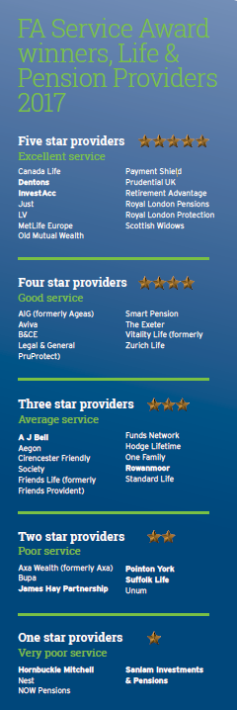
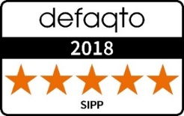
Our awards.
Financial Adviser Service Awards- Five Star Winner:
2012, 2013, 2015, 2016, 2017, 2018
Defaqto- Five Stars
Notes:
That our awards are voted for by IFAs and we have consistently held the 5* category. Only firm to have done this.

Slide 23
Any Questions?
Financial Adviser Service Awards 5* 2012, 2013, 2015, 2016 & 2017
Defaqto 5*
IIC 3* Exceptional
Stephen McPhillips BA, FPMI
Technical Sales Director
stephen.mcphillips@dentonspensions.co.uk
Notes:
Any questions

Slide 24
Disclaimer
Although every effort has been made to ensure that information provided by the speakers and all documentation associated with the seminar is accurate and correct the information provided does not constitute any form of advice, recommendation or opinion. Dentons Pension Management Limited accept no liability for any loss or damage, howsoever caused, as a result of any reliance on any information provided. The information provided is intended for the attendees of the Seminar only.

