Slide 1
Nottingham Insurance Institute 11 April 2019
Damian Glynn BA (Hons) FCA FCILA FUEDI ELAE FIFAA
Director, Head of Financial Risks

Slide 2
Learning outcomes
Understand the key components of business interruption policy wordings in order to:
Explain to policyholders how the cover works
Ensure the correct cover is in place
This is not a case study on how to adjust claims
It is a distillation of claims experience to avoid problems and surprises

Slide 3
Overview - page 1
The core cover - recap
Consequences that are not covered
Maximum Indemnity period
Core cover: Gross Profit and Declaration Linked Policies
Stock
Statute: Insurance Act 2015 and Enterprise Act 2016
Common BI Extensions

Slide 4
Conclusions - page 2
MIP – 12 months is not long enough for a cake shop
Gross Profit – don’t uninsure too much
Avoid (non Declaration linked) BI policies that are subject to average
For Brokers: Eurokey Recycling v Giles 2014
CII/IIL/CILA BI wording report 2012

Slide 5
Core cover operative clause - pages 3 to 6
What does ‘used by’ mean?
Who is the insured?
What does Premises mean?
Is the description of the business right?

Slide 6
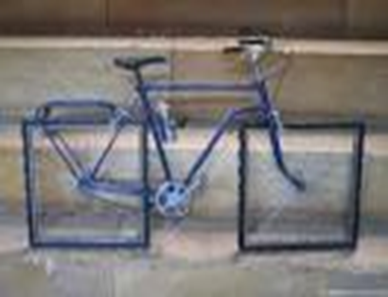
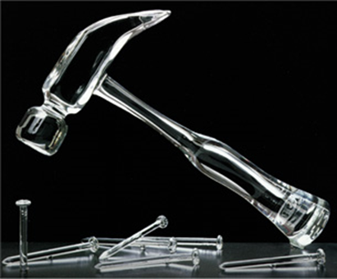
Material damage proviso - page 7

Slide 7
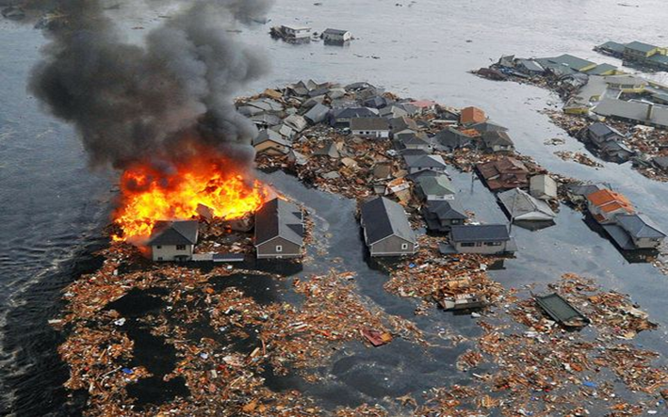
Damage - pages 8 to 10
Definition
Concurrent/dominant causes
Loss flowing from Damage (to property)

Slide 8
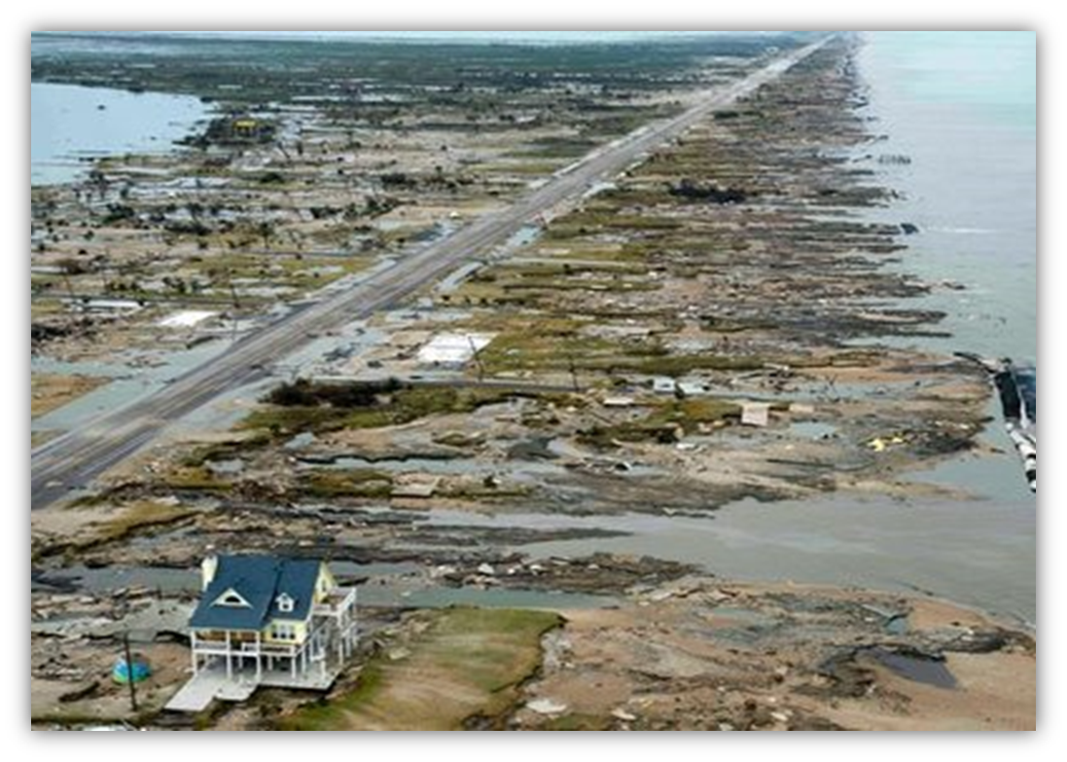
Wide area damage – page 11

Slide 9
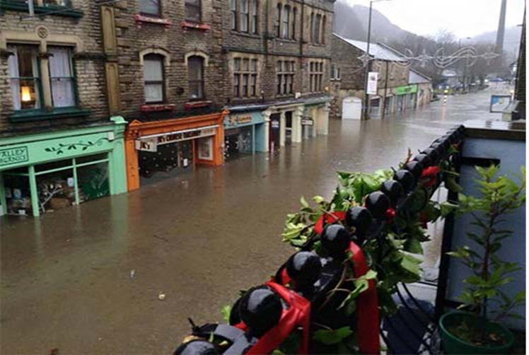
Wide area damage – page 11
Butcher, baker, candlestick maker
Shop’s BI loss driven by damage to the rest of the high street

Slide 10
Wide area damage – page 11
Issue 1: Even if a policyholder suffers Damage, and has BI cover, the policy may not respond due to damage away from the Premises
Issue 2: The greater the extent of physical damage, the less insurers pay as BI (considered on a Premises by Premises basis)

Slide 11
Not all consequences are covered – pages 12 to 14
Contractual Penalties | Post Loss Risk Improvements
Wasted Costs | Gossip/Blemishing
Under Insurance | Normal Wage costs
Landlord’s Intransigence | Management Time

Slide 12
Maximum indemnity period – pages 15 to 17
Definition
Commencement
Ends when the results are no longer affected
Repair and customer recovery phases
12 Months is too short – Café de Lecq v Rossborough 2012

Slide 13
Maximum indemnity period – pages 18 to 23
Staff
Production/operations
Buildings
Site
Vicinity
Supply chain

Slide 14
Gross profit definition – page 24
A commonly used term by accounts for several centuries
A term with a precise meaning in insurance policies

Slide 15
Gross profit – pages 24 to 30
Published accounts/detailed profit and loss account
Fixed/variable costs
The danger of assuming costs will reduce
The danger of assuming a total loss
Purchases
Supply chain

Slide 16
Declaration linked policies – page 31
Not subject to average, but 133.33% limit
33.33% uplift only relevant at the timer of a claim, does not assist an inadequate declaration
Significant levels of under (non) declaration
Reason for under declaration is irrelevant
Insurer’s only sanction is the nuclear option
The current losers are the policyholders that get it right

Slide 17
Stock – pages 32 to 33
BI/Material Damage overlap
Policy cover
Absorbing overheads and standard costs
Stock Debris removal costs (indemnity not re-instatement)

Slide 18
Insurance Act 2015 – page 34
Duty of Fair presentation
Changes to warranties
Penalties for Breach
Is this the end of non average BI cover?
Cross contamination between policy sections

Slide 19
Enterprise Act 2016 – pages 35 to 36
Sprung v Royal Insurance 1999 (England and Wales)
Can’t have Damages on Damages
EA for renewals/inceptions after 4 May
Implied term that SUMS DUE will be paid in a REASONABLE time when a CLAIM is made: Damages may be claimed if in breach
Defences
Contracting out
Not just first party claims

Slide 20
ICW: practical issues – pages 37 to 38
Costs ‘solely reasonably and necessarily’ incurred to avoid a reduction in turnover
Purpose of ICW cover: empowerment to mitigate
On-going agreement of course of action to avoid loss
Not necessary to secure Insurer/adjuster agreement to incur
Interim payments
Application of economic limit

Slide 21
ICW: Practical issues – page 39
How can the economic limit ever really be tested?
AICW (no economic limit but must produce benefit within MIP)

Slide 22
Business interruption extensions – pages 40 to 44

Slide 23
Denial of access/ loss of attraction – pages 40 to 41
Vicinity
Access to/use thereof (egress?)
Non Damage Denial of Access (Act of the competent authority)

Slide 24
Utilities – page 42
Incident at the generating site
Failure at terminal ends
Exclusions

Slide 25
Customers / suppliers – page 43
Specified/unspecified covers
Territorial limits
What is a customer or supplier?
Suppliers of services as well as goods?
Notes:
Are insurers responding to new industry changes? if not how could a loss be proved? Do we need more specific industry wordings?
Wordings still have pre printed SWE although not right for all industries e.g. contractual commitments, but still insurers use these wordings

Slide 26
Advanced profits – page 44
Effect: Deferral of start of MIP
Incident location | Standard Cover | Advanced Profits
Existing Site | Gross Profit from Existing Plant | Gross Profit from planned plant within Maximum Indemnity Period
Greenfield Site | Material damage proviso will not be satisfied | Gross Profit from the time the planned plant would gave started working, but for the Damage
Notes:
Are insurers responding to new industry changes? if not how could a loss be proved? Do we need more specific industry wordings?
Wordings still have pre printed SWE although not right for all industries e.g. contractual commitments, but still insurers use these wordings

Slide 27
Objectives - recap
Understand the key components of business interruption policy wordings in order to:
Explain to policyholders how the cover works
Ensure the correct cover is in place
This is not a case study on how to adjust claims
It is a distillation of claims experience to avoid problems and surprises

Slide 28
THANK YOU

