Slide 1
Professional Financial Advisers
October 2018
Vulnerable clients – vulnerable business!
Helen Morrissey

Slide 2
LEARNING OUTCOMES
Being able to demonstrate an understanding of dementia & how to communicate
Gain an understanding of the FCA’s stance on vulnerable client
Understanding how to create a dementia plan for the client
Understanding of differing ‘responsible parties’ and their powers
1
2
3
4

Slide 3
64

Slide 4
51

Slide 5
Ask yourself…
?
?
?
If a client
has a power of attorney or a court deputy appointed through the court of protection, would the attorney/duty know
to contact you?
If an existing client was suspected or diagnosed with dementia would their children ring you?
If you suspected there was an issue with a client, would you always know who to contact?

Slide 6


HOW MUCH OF AN ISSUE?
850,000
Every
one person in the UK develops dementia
people in the UK live with dementia
3
minutes
The only one of the top
of death that can’t
be prevented
#1
10 causes
….one of the biggest global challenges of our lifetime
Source: Alzheimer’s Society, 2018

Slide 7





Am I at risk?
20+, 40+, 60+,
+
Alcohol
Age
Male, Female
Medical
conditions
Cigarettes
Lifestyle
factors
Exercise
regularly

Slide 8

WHAT IS DEMENTIA?
An umbrella term
Dementia is an umbrella term that describes a set of symptoms that may include memory loss and difficulties with thinking, problem-solving or language.

Slide 9
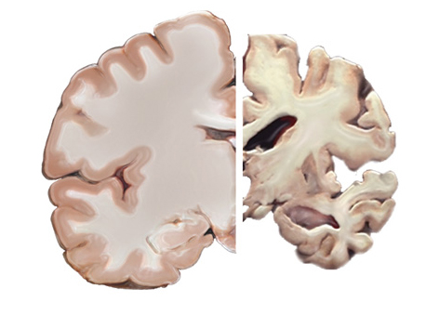
ALZHEIMER’S
Physical disease of the brain
Healthy Brain
Severe
Alzheimer’s
Alzheimer's disease, named after the doctor who first described it (Alois Alzheimer), is a physical disease that affects the brain.
During the course of the disease, proteins build up in the brain to form structures called 'plaques' and 'tangles'. This leads to the loss of connections between nerve cells, and eventually to the death of nerve cells and loss of brain tissue.
Source: Alzheimer’s Society, 2018

Slide 10

MEMORIES
A lifetime in the making
Source:: Adobe stock photo, 2019

Slide 11
LACKING MENTAL CAPACITY…MCA 2005 sct2!
  ‘A person must be assumed to have capacity unless it is established that they lack capacity’
  1
At the material time, they are unable to understand the information relevant to the decision
  2
At the material time, are unable to retain information
  3
At the material time, are unable to use or weigh information as part of the decision making process
  4
At the material time, are unable to communicate their decisions by any means, verbal or non-verbal!
  5

Slide 12
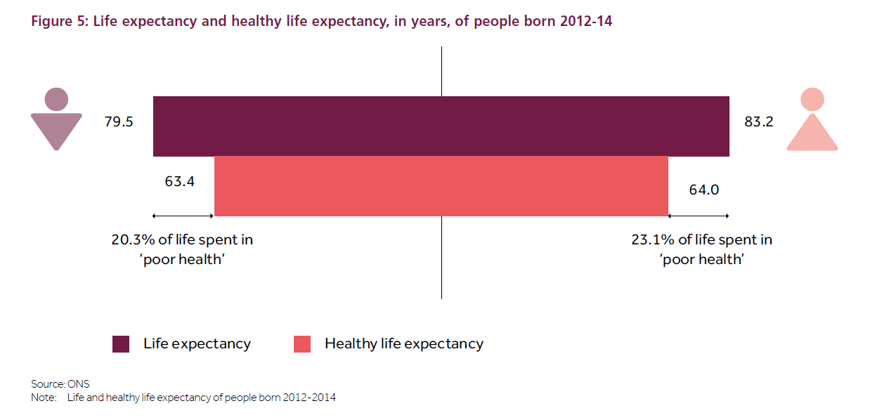
Fca business plan 2017/18

Slide 13
VULNERABLE CUSTOMERS
Dementia in the context of Financial Services
“
“
Someone who, due to their personal circumstances, is especially susceptible to detriment, particularly when the firm is not acting with appropriate levels of care.
(FCA Consumer Vulnerability Paper, February 2015)

Slide 14
consumer vulnerability
Much consumer protection legislation looks at average or typical client – vulnerable client more likely suffer harm
Firms need to ensure that consumers are adequately protected.
Deal with vulnerable clients is a reality due to the long-term nature of commitments.
Vulnerability includes dementia – often not recognised by the affected individual or their partner

Slide 15
firm strategy:
Begin building strategy by auditing current practice
Treat the client as an individual
Offer the client a flexible and tailored response to a change in circumstances
Provide a tailored approach and offer the use of specialist sources of help and advice if necessary
Sufficient training for frontline staff to have ‘proper conversation’
Good policies and practice in handling disclosure or communication needs
Ongoing evaluation

Slide 16
firm strategy:
Begin building strategy by auditing current practice
Treat the client as an individual
Offer the client a flexible and tailored response to a change in circumstances
Provide a tailored approach and offer the use of specialist sources of help and advice if necessary
Sufficient training for frontline staff to have ‘proper conversation’
Good policies and practice in handling disclosure or communication needs
Ongoing evaluation

Slide 17

HAVING A CONVERSATION
Some ground rules
Talk to the person, not about them
Use names, rather than he/she
Avoid badgering the witness!
Speak one at a time and do not interrupt
Break it down, rephrase, don’t repeat
Active listening
Think about speech, pace & expressiveness
Seek first to understand and then be understood
Start with the end in mind

Slide 18




EFFECTIVE COMMUNIATION, IT’S NOT WHAT YOU THINK!
Person
Place
Position
Proximity

Slide 19
firm strategy:
Begin building strategy by auditing current practice
Treat the client as an individual
Offer the client a flexible and tailored response to a change in circumstances
Provide a tailored approach and offer the use of specialist sources of help and advice if necessary
Sufficient training for frontline staff to have ‘proper conversation’
Good policies and practice in handling disclosure or communication needs
Ongoing evaluation

Slide 20
Ask yourself…
?
?
?
If a client
has a power of attorney or a court deputy appointed under the court of protection, would the attorney/duty know
to contact you?
If an existing client was suspected or diagnosed with dementia would their children ring you?
If you suspected there was an issue with a client, would you always know who to contact?

Slide 21

What if Bob called you?
He is married to Doris and both have been clients for a long time.
They always talk to you together.
Bob always discussed with you that his wish is that Doris is looked after should anything happen to him.
Today Bob rings you and requests that he wants to give £20,000 each to ‘the best colleagues he ever worked with’… Geoff, Clive, George, Steve and Chris ,who still take him for a round of golf every year since he retired in 2010.
He would like to use his offshore bond currently worth £100,000 to pay them.
What would you do in this situation?

Slide 22
What if Bob called you?
He is widowed and has been a client for a long time.
Since Doris died Bob always discussed that he wished to leave his assets to his daughter to make sure she can support herself. Whilst you have a good relationship with Bob you have never met his daughter.
Today Bob rings you and requests that he wants to give £20,000 each to ‘the best colleagues he ever worked with’… Geoff, Clive, George, Steve and Chris ,who still take him for a round of golf every year since he retired in 2010.
He would like to use his offshore bond currently worth £100,000 to pay them.
What would you do in this situation?

Slide 23
Lets start building a dementia plan:
Financial Passport
Details of relevant persons
Supporting you in later life
Financial review
Communications
Ongoing review process

Slide 24
Financial Passport
Document setting out clearly where everything connected to the client’s financial and personal affairs can be found.
Goes beyond a financial fact find
Includes all professional relationships with full contact details – including doctor, solicitor, accountant
Understanding of who they would like you to contact and their responsibilities

Slide 25
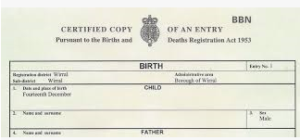
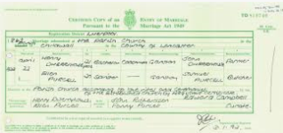

Proof of identity!
Birth certificate
Marriage certificate
Passport
National Insurance number

Slide 26

agreements:
LPA
Will
Deeds to the house
Policy documents
Insurance documents – house, car, protection
Utilities – providers, account numbers
Loans, credit cards, mortgage – provider, account number
Funeral plan

Slide 27

Legal capacity:
Guardian
Attorney – LPA
Deputy – Court Of Protection
Trustee
Executor
Board member
Any other positions

Slide 28

Online challenge!
HMRC
Policy Documents
Bank Accounts

Slide 29
Responsible parties
Appropriate
person
Court of Protection
Lasting Power of Attorney

Slide 30
LASTING POWERS OF ATTORNEY
Enables a client to appoint those people they selected to act as their attorney and to look after affairs in the event that they lack mental capacity

Slide 31
LASTING POWERS OF ATTORNEY
Applied for prior to lacking capacity
Registered with the Office of the Public Guardian (OPG).
Validated if stamped ‘VALIDATED-OPG’
LPA can be revoked at a later date
Minimum of 1 attorney – no maximum
If multiple attorneys, they can make decisions together or individually
Attorney cannot be bankrupt or subject to a debt relief order
Make sure it includes all required permissions
Consider how well the client knows the attorney, trusts them, and how they look after their own affairs
Relatively small cost (£500 - £1000 DEPENDING ON COMPLEXITY) plus £82 registration fee

Slide 32
How many LPA’s
Health and Welfare
Financial
Business???

Slide 33
Types of business owners:
Sole Traders
Partners (general partnerships and limited partnerships)
Partners (limited liability partnerships)
Company directors (April 2013)

Slide 34
No business power of attorney!
6/7 months on average to appoint deputy
No one could make lawfully make financial decisions on the individual’s behalf
Bank accounts may be frozen
Suppliers, staff, unfinished transactions, contracts affected
Business forced to close!

Slide 35
Business Lasting Power of attorney (BLPA)
Distinguish Powers Of Attorney (POA) more about commercial situations
BLPA extension of crisis management
Reduce business risk
Choice of appropriate attorney
Some professions require specific qualifications and authorisation
Appropriate to business legal agreements, e.g., partnership agreement
Deal with property owned/leased, organise insurance, access banks statements/accounts, invest assets
Deal with tax affairs, pay staff and suppliers
Sign contracts
Carry on the business

Slide 36
BLPA – document the Intention!
Sufficient mental capacity at time of executing
Understanding of the purpose of the BLPA
The consequences from the BLPA
The consequences for the choice of attorney(s)
Free choice
No undue pressure or influence

Slide 37
Regular review of lpa’s:
Loses the ability to make decisions - ‘loses mental capacity’
Divorces the donor or ends the civil partnership
Becomes bankrupt or is subject to a debit relief order, if a property and financial affairs attorney
Removed by the Court of Protection
If your only attorney dies and there are no replacement attorneys.
Donor dies

Slide 38
Court of Protection
Appointed on financial and/or welfare matters
Business attorney!
Court will decide the powers of the deputy and oversee them
More administration and cost than LPA long term
2 or more deputies can be appointed
Court decides if decisions made together or individually
Professional paid deputies can be appointed

Slide 39



Fees for court of protection
Application Fee
Annual Supervision Fee
Security Bond

Slide 40
Quilter cheviot & court of protection
Clear understanding intricacies of the deputy’s role, responsibilities and requirements
Working relationships with offices of the Court of Protection, Office of the Public Guardian and legal practitioners
Knowledge means we are able to assist deputies and financial advisers in creating tailored financial planning

Slide 41
Appropriate person
Giving an appropriate trusted person the authority to oversee and discuss your financial affairs with the relevant parties.

Slide 42
Responsible parties
Appropriate
person
Court of Protection
Lasting Power of Attorney

Slide 43


understanding clients wishes:
Choice
Control
Comfort

Slide 44
Care dilemma
Do you understand the system or the options available?
Do you know the available benefits and paying for care?
Can you help the family agree the best way forward?
Can you help them during a time of stress, emotional and pressed for time?

Slide 45
benefits system complicated!
Attendance allowance
Intermediate care
NHS- funded nursing care
NHS continuing healthcare
Personal Independence Payment
Disability Living Allowance
Council tax discounts and exemptions
Benefits for carers

Slide 46
FCA Vulnerability paper 2015 :
Begin building strategy by auditing current practice
Treat the client as an individual
Offer the client a flexible and tailored response to a change in circumstances
Provide a tailored approach and offer the use of specialist sources of help and advice if necessary
Sufficient training for frontline staff to have ‘proper conversation’
Good policies and practice in handling disclosure or communication needs
Ongoing evaluation

Slide 47

Take the scare out of care
Experience in the care sector
Understand the benefits available
Understand the different types of care available
Know the care available local to your clients
Costs

Slide 48
Financial review – Additional considerations
Specific needs to fund long term care
Need advice to provide income maximising tax allowances available
Dementia is more about capacity for loss than attitude to risk
Income will be a big driver - document everything via a ‘Withdrawal Policy Statement’

Slide 49
Withdrawal policy statement…protection!
Evidence!
Agreed rules!
How will the journey be managed?
How will the plan deal with various headwinds along the course?
How should the clients outgoing requirements be drawn?
How likely is the plan likely to succeed and reach desired destination?
How much can realistically be drawn along the way?
Feedback form!

Slide 50
The final step – communication!
Client summary
Responsible parties communication
Regular reviews
1
2
3

Slide 51
Getting going!
FCA Vulnerability Report
Client Circumstances
Additional Service Offering
At Client Review

Slide 52
Extending your footprint!
The Client:
Increased service/Sticky client!
Different conversations!
Trusted Parties:
Opportunity to communicate with all parties
Offer service to trusted parties/relatives
Professional Connections:
Build a panel for referrals for LPA’s
Summary of plan to professional connections

Slide 53

And finally…
Supporting you in later life

Slide 54

ANY QUESTIONS?

Slide 55
DISCLAIMER
This presentation has been prepared only for the recipient and date shown on the front page. It is not intended for any other persons and should not be relied upon by other persons.
This presentation has been prepared for information purposes only and is not a solicitation or an offer to buy or sell any security. It does not purport to be a complete description of our investment policy, markets or any securities referred to in the material. The information on which the presentation is based is deemed to be reliable, but we have not independently verified such information and we do not guarantee its accuracy or completeness. All expressions of opinion are subject to change without notice. Any reference to the Quilter Cheviot model portfolio, which is used for internal purposes, is purely illustrative and should not be relied upon. The figures quoted do not include charges.
Investors should remember that the value of investments, and the income from them, can go down as well as up and that past performance is no guarantee of future return. You may not recover what you invest. Changes in exchange rates may have an adverse effect on the value, price or income of foreign currency denominated securities. Levels and bases of taxation can change. Investments or investment services referred to may not be suitable for all recipients.
Quilter Cheviot Limited is registered in England with number 01923571, registered office at One Kingsway, London, WC2B 6AN. Quilter Cheviot Limited is a member of the London Stock Exchange and authorised and regulated by the UK Financial Conduct Authority.

