Slide 1
Personal Finance Society: the economic outlook for 2021
9th December2020
Professor Trevor Williams, University of Derby and IEA SMPC

Slide 2
OVERVIEW
The world is experiencing the worst global pandemic since the 1918 Spanish Flu. A mandated shut down to save life has resulted in a global recession, of 5% this year.
UK growth is likely to drop by twice that, at 11% or so before recovery next year of 5%. Monetary and fiscal policy have been loosened dramatically to help achieve this.
In the UK, Bank Rate is down to 0.1%. QE is now at £875bn and the fiscal deficit will be around £400bn. Next year, Brexit will take place. A trade deal is in doubt, and even with one there will still be disruption (long term gdp loss of 4%).
Economic growth will be positive, but weak in 2021. Winners are tech; losers are hospitality, travel, leisure. Risks from company defaults, and higher unemployment.

Slide 3
UK growth was amongst worst in H1 2020…
UK GDP growth fell by a cumulative 22.1% in the first half of 2020
Source: IMF,TWC.
3

Slide 4
This is unquestionably one of the UK’s worst downturns…
Output, hours and productivity in previous recessions
4

Slide 5
But recovery is underway…though small fall likely in Q4
Percent change on a quarter earlier
Source: ONS.

Slide 6
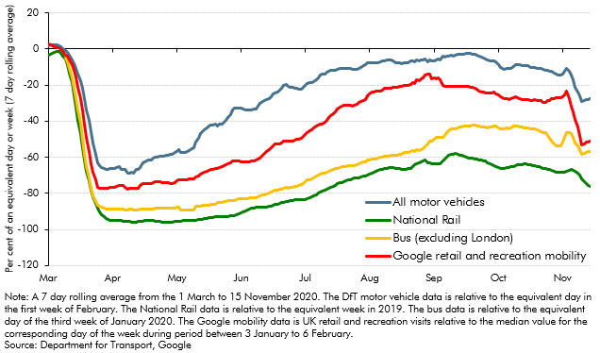
The recent slowdown is evident in data as second lockdown bites…
But it’s a lot less impactful than in Q2

Slide 7
Worst hit sectors are hospitality, leisure, pubs, restaurants but off lows…
Value added basis, by sector

Slide 8
…and next year the UK could have one of the fastest growth rates
Source: National statistical offices and Citi Research.
8

Slide 9
UK economic outlook & scenarios – which outcome is most likely next year?
Too soon to be certain about anything - best to think in terms of scenarios
UK 2021 economic scenarios
 | Upside scenario | Central scenario | Downside scenario
Real GDP in 2020, % change on previous period | 7.0 | 5.5 | 2.0
Peak in unemployment % | 6.5 (Q1 2021) | 7.5 (Q1 2021) | 10.2 (Q4 2021)
Public sector net borrowing (£ billion) | 150 | 164 | 265
Public net debt 2020-21 (% of GDP) | 105 | 108 | 112
9
Source: UK OBR

Slide 10
  Audience poll
Which Growth Scenario do you think is the most likely for 2021?
A. Upside Scenario
B. Central Scenario
C. Downside Scenario

Slide 11
Unemployment could be as high as 11% or as low as 4%
UK unemployment rate%
11

Slide 12
Share of SME jobs at risk due to illiquidity, caused by COVID-19
12
Source: UK ONS

Slide 13
Consumer and business confidence has taken a big hit
Consumer confidence
Business confidence
(a) Difference from averages since 2000.
(b) Planned investment in plant and machinery over the following year relative to the previous
year. Sectors within CBI (manufacturing, distribution, financial services and business/consumer/
professional services) are weighted together using shares in real business investment.
(c) Based on reported changes to planned investment in plant and machinery over the past
three months. Weighted average of the manufacturing and services sectors based on shares in
real business investment.
(d) Planned expenditure on tangible non‐financial assets over the following 12 months.
Source: UK ONS
13

Slide 14
A wide possible outcome for debt as a share of GDP…
Debt could be as high as 124% of GDP or as low as 97%

Slide 15
…Public sector borrowing should fall quickly but stay high as a share of GDP
Borrowing is set at 19.3% of gdp or £394bn this year alone
Source: OBR

Slide 16
…some context is required – debt can fall quickly if the economy grows

Slide 17
  Audience poll
  How long will it take for the UK to regain it’s pre-COVID peak?
  A. 1 year for the optimists
  B. 2-3 years
  C. 3 years or more for the pessimists

Slide 18
It could take 4 years for UK to regain its pre-COVID-19 peak…
18
Source: NIESR

Slide 19
Growth to be on a weaker trend than previously…
UK economic growth indexed to 2019 Q4

Slide 20
But businesses are reopening…
Across all industries, 96% of responding businesses reported they were currently trading
Percentage of businesses, current trading status, broken down by industry, UK
20
Source: Office for National Statistics – Business Impact of Coronavirus (COVID-19) Survey

Slide 21
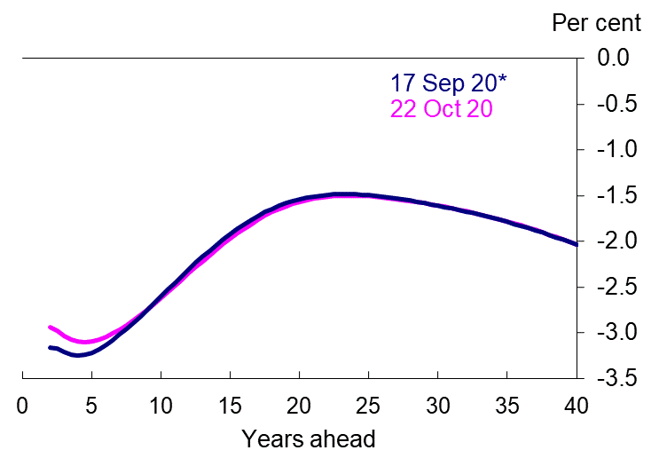
The cost of borrowing is at record lows…
Financial market-implied rate expectations of Bank rate
The real cost of borrowing is highly negative across the yield curve
* MPC meeting

Slide 22
Market inflation expectations have increased but remain subdued
Source: UK ONS

Slide 23
…and UK consumer price inflation is expected to stay well below the 2% target

Slide 24
With looser policy, UK money supply is rising…
Source: Bank of England
24

Slide 25
So, will household saving rates fall – releasing pent up demand
Saving rate already falling…
...so real business investment to bounce in consequence
25

Slide 26
…but lenders have tightened credit conditions
Spreads on selected fixed‐rate mortgages(a)
Household unsecured credit availability(a)
Rise in credit availability
Fall in credit availability
Spreads have widened
26

Slide 27
However, the housing market has recovered somewhat
Mortgage approvals and housing transactions recover
House price inflation picks up speed
27

Slide 28
But can this last as unemployment rises and incomes are squeezed
There has been a sharp rise in the number of redundancies
Median pay settlements have fallen to zero
redundancies
28

Slide 29
So far, no has UK households are repaying consumer credit debt
29

Slide 30
…they know that support will be mostly withdrawn in early 2021
30

Slide 31
…Current monetary flows in the economy are misleading
The spike in government borrowing to around 19 per cent of GDP has meant that household and corporate incomes have not fallen nearly as fast as their output or expenditure.
As a result, the household financial surplus has risen to historically high level of over 11 per cent of GDP in 2020, while the corporate balance moved from deficit into a historically high surplus of 2.5 per cent of GDP.
But, as the economy recovers and household and corporate spending rise more into line with income, government borrowing will fall.
So, sectoral net lending positions will return to more usual levels while there remains a large and stable rest of world surplus (a current account deficit).
31

Slide 32
The pound is holding up well given Brexit risk
Spot exchange rate, Euro into Sterling
UK votes to leave EU, 23 June 2016
UK General Election, 11 December 2019
COVID-19 hits
Source: Bank of England

Slide 33
Has public opinion changed?
*Nov 18th 2020
Source: Natcen for social research
33

Slide 34
Brexit remains an important source of uncertainty for 50% of firms
Source: Bank of England
(a) The results are based on the questions: ‘How much has the result of the EU referendum affected the level of uncertainty affecting your business?’; and ‘How important is the spread of coronavirus (Covid-19) as a source of uncertainty for your business?’.
34

Slide 35
How will Brexit impact UK firms?
Expected channels by which EU exit will affect businesses(a)
Source: Bank of England
Source: Agents’ survey on preparations for EU withdrawal.
(a) Question: ‘What are the main channels for any impact of EU exit on your company?’.
35

Slide 36
The sectoral impact of Brexit
No tariff barriers are more important than tariff ones
Source: IFS Green Budget, Citti
36

Slide 37
Firms are preparing as best they can
Types of preparation firms are undertaking
Source: Agents’ survey on preparations for EU withdrawal.
37

Slide 38
Paradoxically, or not, global trade uncertainty has fallen
Despite Brexit world trade prospects are looking better
Source: EU Financial Stability Report, November 2020
38

Slide 39
A ‘left behind’ measure
Source: IFS
39

Slide 40
How does the government plan to fix it – can it?
‘The only sustainable way to drive economic growth and improve living standards in every corner of the country is to boost productivity.
The government is therefore investing in people and places – by taking the first steps in its plan to level up skills across the country, ahead of setting out further details at the [Spending Review], and by committing record levels of investment to infrastructure that will directly support productivity.
These actions will boost national growth as well as addressing economic and social disparities and restoring the fabric of our towns and cities.’
Source: IFS Green Budget, Citti
40

Slide 41
Conclusion
Low borrowing costs afford an opportunity to invest in infrastructure. And it would permanently boost the economy.
Safety nets must be maintained as needed for low-income families, to access to unemployment benefits, to broader cash and in-kind
Brexit is a done deal so will have to be seen an opportunity for those UK firms that find workarounds as new deals are done, plugging gaps and innovating for new markets.
The good news is that the pace of technological process has not slowed and will continue to accelerate. UK needs to reap its benefits to grow out of debt rather than impose tax increases and spending cuts.
Support low-carbon and climate-resilient growth, including through smart allocation of public spending; and take advantage of the digital transformation, whether through greater use of e-government platforms to enhance efficiency and transparency while cutting red tape, e-learning, or remote work.

