Slide 1
Interview Skills
With Susan Heaton-Wright

Slide 3
What are we going to cover
Quick information about videos when applying
The 5 ‘w’s
Preparation
Tips for the big day
Being in the moment
The follow up after an interview
Receiving feedback
Face to face and virtual interviews

Slide 4
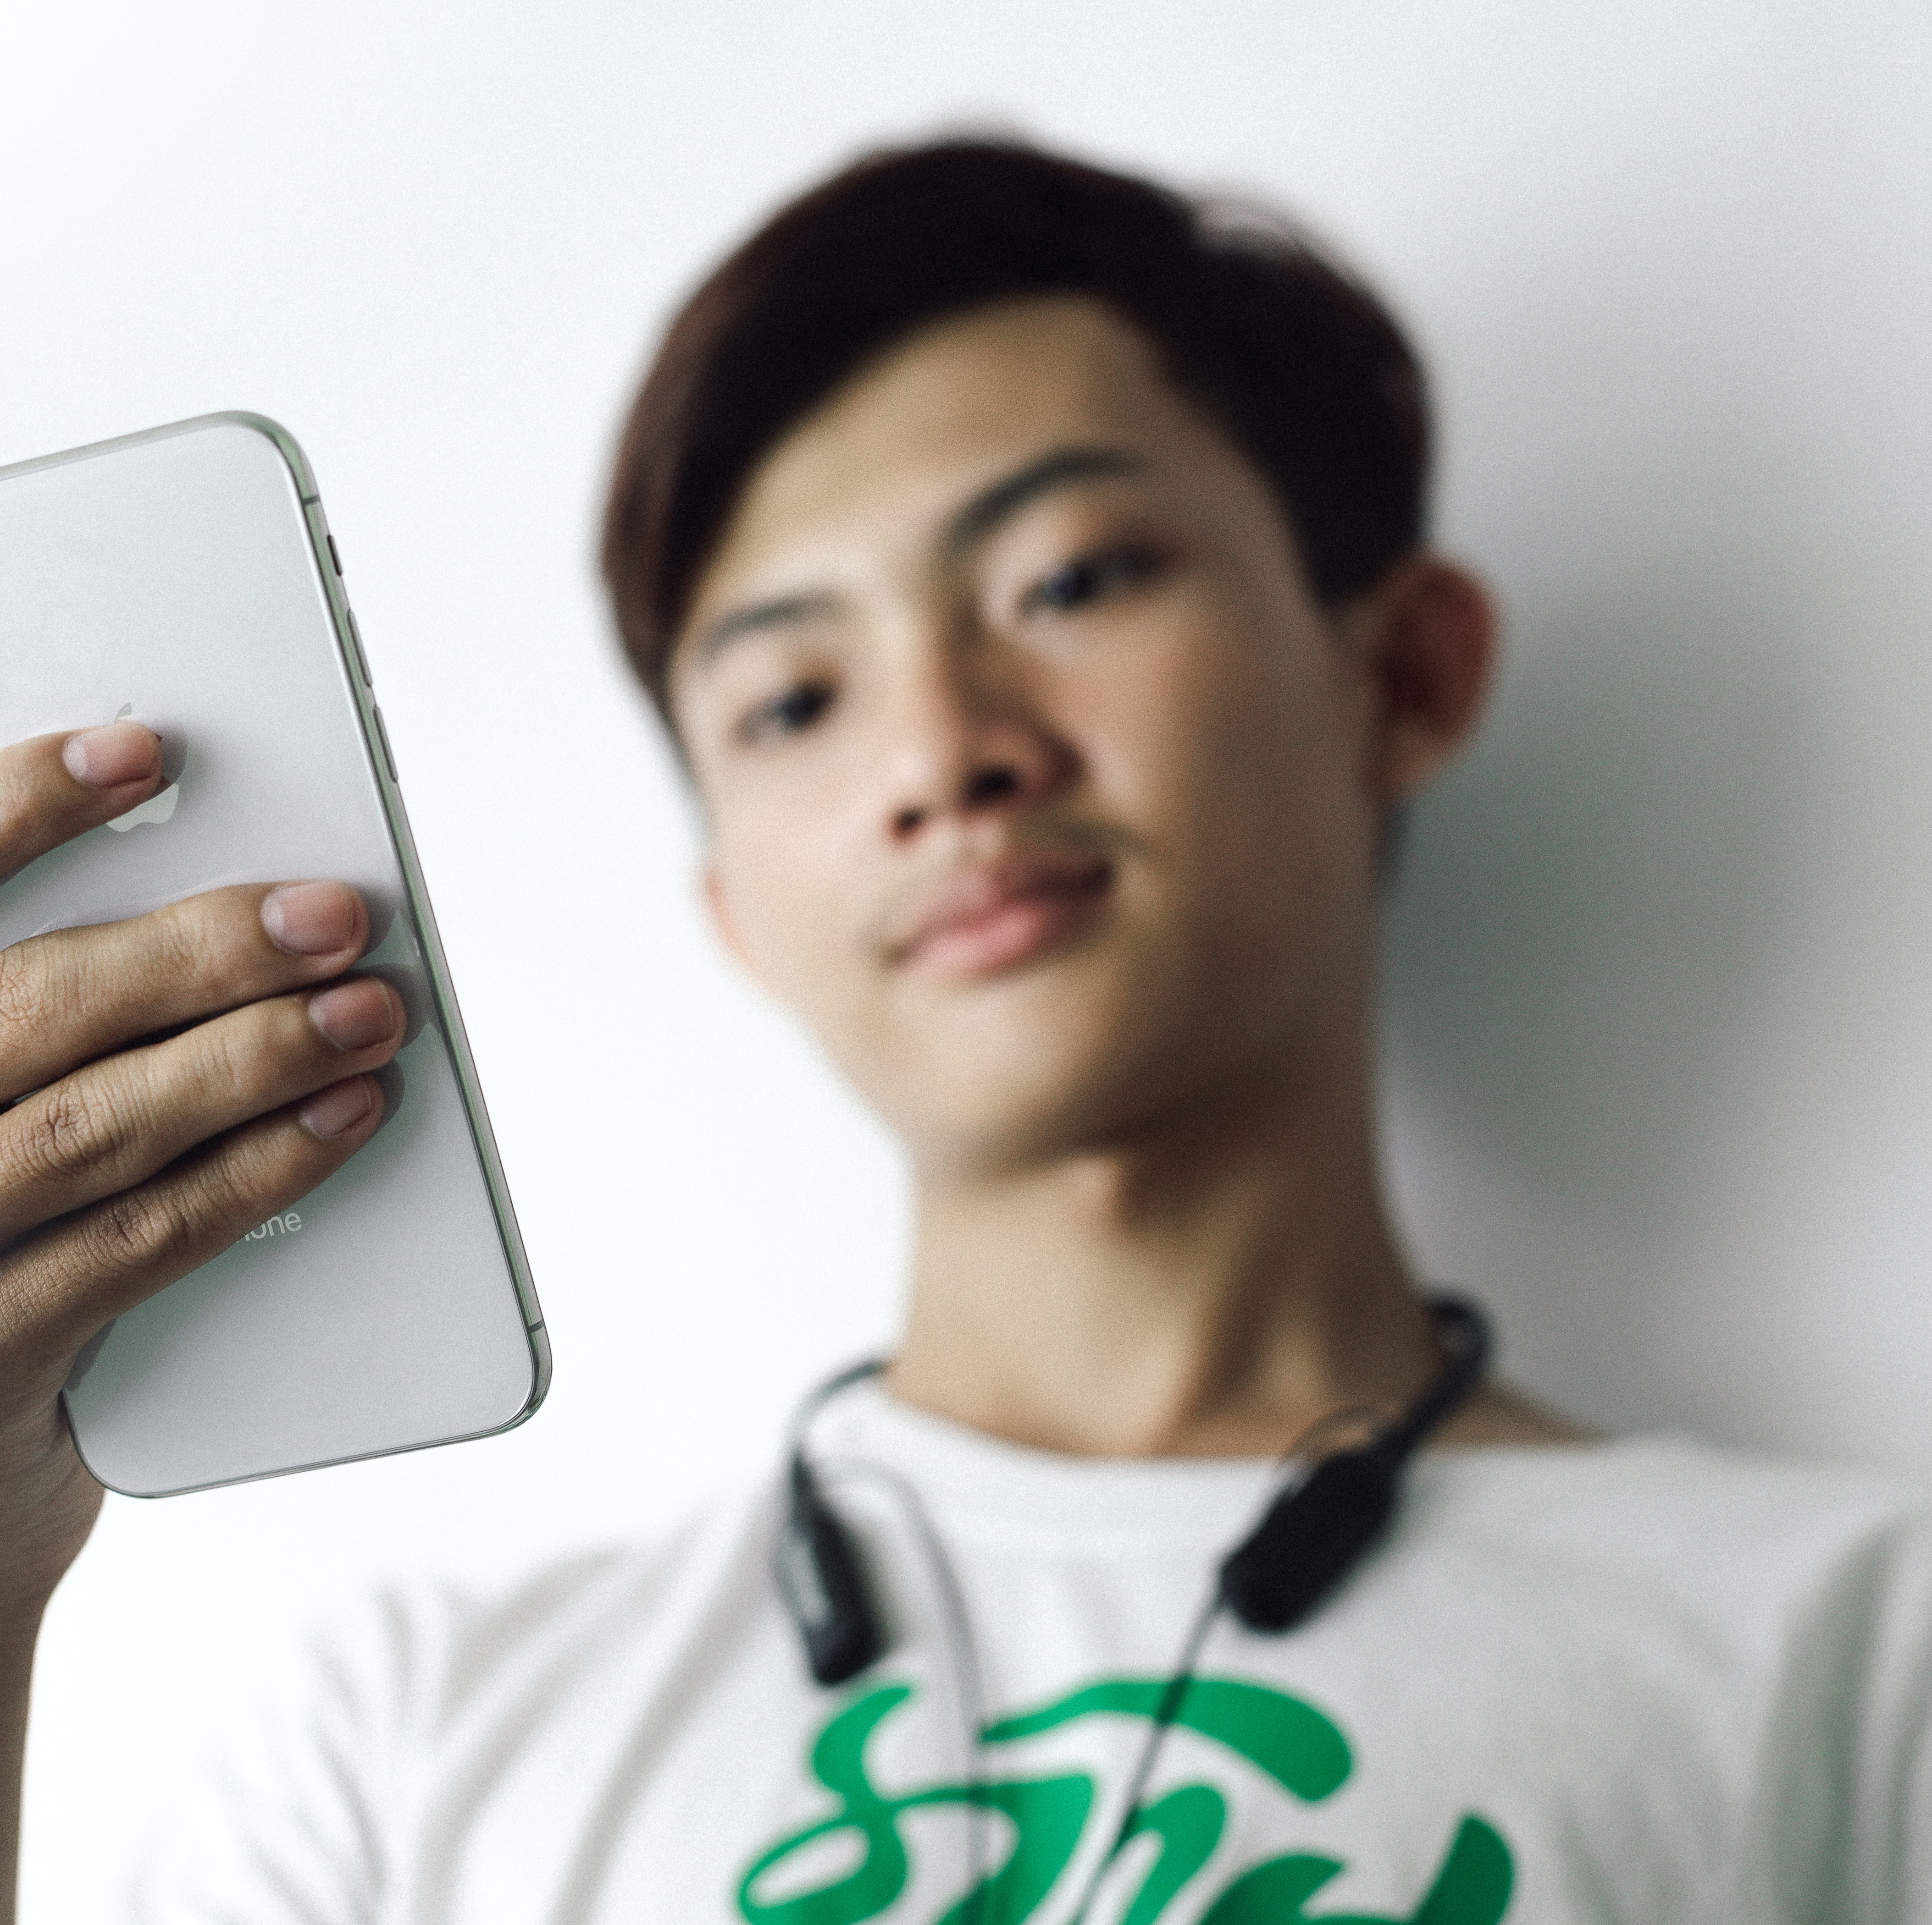
Video
On a phone or lap top
Say your name
Look at the screen
You might be asked to say something about yourself
If not asked to include a video – do so to introduce yourself!

Slide 5
5 ‘W’
Question | Example
What | Are you applying for
When | When is the interview
who | Are you meeting
why | Are you applying (what is the why for you)
where | Face to face or virtual
HOW | Will the interview be conducted? Series of interviews, tests

Slide 6
What?
Chat

Slide 7
When?

Slide 8
Who?
Q2

Slide 9
Why?
Why are you applying?
What is special about this role?

Slide 10
Where?
How to you check?

Slide 11
How?
Q3

Slide 12
Preparation

Slide 13
practice

Slide 14
Planning your journey

Slide 15
What to wear?

Slide 16
Handshake?
Chat?

Slide 17
Notes:
Do you recognize these postures.

Slide 18
Eye contact

Slide 19
Listen

Slide 20
Be in the moment
Q4

Slide 21
What are you going to say?

Slide 23
I think
I believe
The Truth is

Slide 24
Job Description V your experience
Chat – how to illustrate this

Slide 25
p6

Slide 27
Directions Story

Slide 29
Tips for answering questions
Repeat the question
Look at the interviewer
Keep on message
Use examples
Any other ideas?

Slide 30
Consider some questions to ask

Slide 31
Virtual interviews

Slide 32
Messy room!

Slide 33
Sound and microphone

Slide 34
Lighting

Slide 35
After the interview

Slide 36
Asking for feedback

Slide 37
First action as a result of this workshop

Slide 39
Superstar Communicator APP
https://bit.ly/2Wza2gO
Available on Apple and Google play
Go to ‘Slides, notes. Learning’
NXT GEN

