Slide 1
The Policy, Loss Mitigation & Business Recovery
Angus Tucker
March 2016

Slide 2
Introduction
An introduction from
Angus Tucker
Managing Director
Lorega Solutions

Slide 3
Order of Events
Structural and technical issues relating to the business interruption cover.
Loss Mitigation
Specific Examples
Questions and feed back

Slide 4
Policy Cover
Policy intentions
Basic Components of the BI cover
Policy extensions / exposures

Slide 5
Intention & Aims
To provide financial support for the business following a loss
To fund loss mitigation and catastrophe plans
To provide continued cash flow for the business
To enable the business to demonstrate internally / externally that they are still functional.

Slide 6
Policy Components
Setting the Sum Insured
Agreeing an appropriate Period of Indemnity
Declaration Linked / Average
Inception / Renewal issues

Slide 7
Sums Insured
Gross Revenue / Gross Profit
Setting the correct sum insured
Asking the right questions
Matching the sum insured with the policy definition
Thinking 24 months ahead – Why?
Proportional increases for extended indemnity periods

Slide 8
Length of Indemnity Period?
Customer base
Lead times for reinstatement
Vulnerability of the Insured business sector
Restrictions on loss mitigation / relocation
Seasonality

Slide 9
Declaration Linked / Average
Declaration linked has no average
Provides limit of 133% of Sum Insured
Requires close annual review
Premium rebate if over insured
Average does not allow any flexibility

Slide 10
Policy Extensions
Additional increase costs cover (AICWE)
Denial of Access
Customer extension
Supplier extension
Failure of Utilities
Infectious Diseases etc

Slide 11
Business Interruption/Rent
Occasions when these need aligning
Buildings insured for other interests (Directors pension fund, landlord)
Formal lease including cessation of rent clause
Rent cover exposure

Slide 12
3. Mitigating the loss

Slide 13
Things to be considered
Property damage & impact on business
Effective use of Increased Costs
Business Recovery Focus

Slide 14
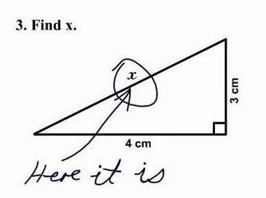
Early thoughts
Loss mitigation needs to start immediately
Is there a BCP?
Will the policy respond, if so when?
Effect on BI loss down the line
Act as though uninsured

Slide 15
Premises
Extent of damage
Practicality / capacity of alternative sites
Owned or leased (term, break clauses)
Public Authority issues – planning, HSE, Environmental
Alternative premises – permanent or temporary?

Slide 16
Customers
Indentifying the customer base for the business
Key customer retention
Communications
Contractual arrangements

Slide 17
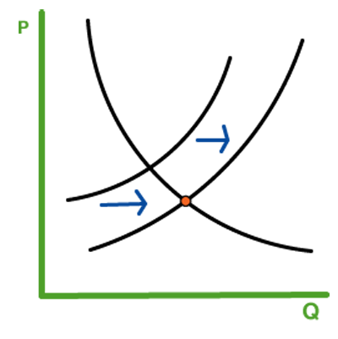
Production / Supply
Degree of disruption
Reinstatement lead-times
Temporary equipment
Sub contracting
Using other facilities
Buy in partially completed
Competition

Slide 18
Stock
What is affected -finished goods, work in progress, raw materials
Lead times
Buy back from customers
Air Freight options

Slide 19
Suppliers
Communication is essential
Payment for historic and replacement stock
Can suppliers assist in recovery plan?
Can supplies be brought forward to fill a void?
Build supplies into the recovery plan

Slide 20
Cash flow
Priority for most policyholders
Why it is important at an early stage?
Benefits for both sides
Book review / interim payment meetings in advance
Support expenditure and agree benchmarks early

Slide 21
4. Case studies

Slide 22
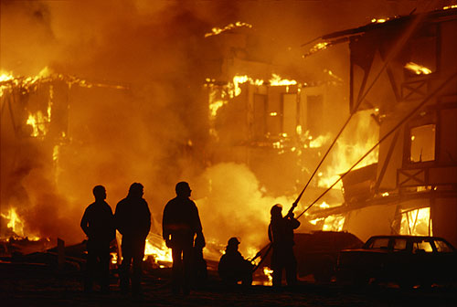
Case study 1 – fire

Slide 23
Summary of case
Prestigious West End Restaurant
Fire in extract duct
Kitchen destroyed
Restaurant extensive damage
Lower ground floor theme bar water and smoke damaged

Slide 24
Issues
Weekly GP - £60,000
Time critical for reinstatement
Potential time for specification and tenders – 3 months minimum
Agreed project manager and specialist single contractor for repairs
Full transparency – detailed daywork logs

Slide 25
Issues
Complete strip out within 2 weeks
Immediate commencement of repair work
Fire occurred 30 July
Reopened 28 September
8 weeks –
ICW costs circa £60,000
BI saving £1m+

Slide 26
Case study 2 – commercial explosion

Slide 27
Summary of case
Printing machine retail
Leased premises corporate landlord
Location: Buncefield trading estate
Policy cover: machinery/contents,
Tenant’s improvements, business interruption.
Massive explosion of oil storage tanks

Slide 28
Issues
Extensive damage to office fit out and stock
Initial assessment of building was positive
After internal works completed landlord reassessed the building damage
Damage to buildings required business to vacate for 6 months

Slide 29
Issues
Landlord required vacation of building with one months notice
Mezzanine ceilings and partitions would have to be taken down and reinstated at tenant’s expense
No suitable alternative properties available locally
Move away from the area would have resulted in loss of staff and business

Slide 30
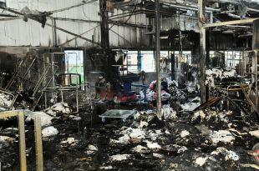
Case study 3 – laundry

Slide 31
Summary of case
Main customers P&O Ferries, Hotels, The British Army
Own premises located outside Dover
Policy cover: machinery/contents, goods in trust, buildings, business interruption
Fire destroys entire premises

Slide 32
Issues
Planning concerns
Environmental issues
Retaining contracts with key customers
Lead time for replacement machinery
Period of interruption could be up to 24 months

Slide 33
The Policy, Loss Mitigation & Business Recovery Q&A

