Slide 1

Property Recoveries
January 2023

Slide 2

Property Recoveries: Introduction
To provide an understanding of subrogation in property damage claims, how it works in practice and key aspects that impact recovery

Slide 3

Property Recoveries: Learning Outcomes
What is subrogation and how it arises in property damage claims?
Life cycle of a subrogated claim
Causes of action (Contract, Negligence, Nuisance, Statutory) and how they enable us to pursue a subrogated claim
Damages – the types of recoverable and irrecoverable loss and issues that impact recovery (betterment, mitigation, uninsured losses and pure economic loss)
Practical tips on how to maximise recoveries

Slide 4
What is Subrogation?
Insurers can subrogate either by the terms of the policy or under common law doctrine.
Pursuing recoveries helps insurers to improve their loss ratios across books of insurance.
The requirements for subrogation are:
      the insurance is a contract of indemnity
      the insurer has made a payment under the policy
      the right of subrogation is not excluded under the policy

Slide 5
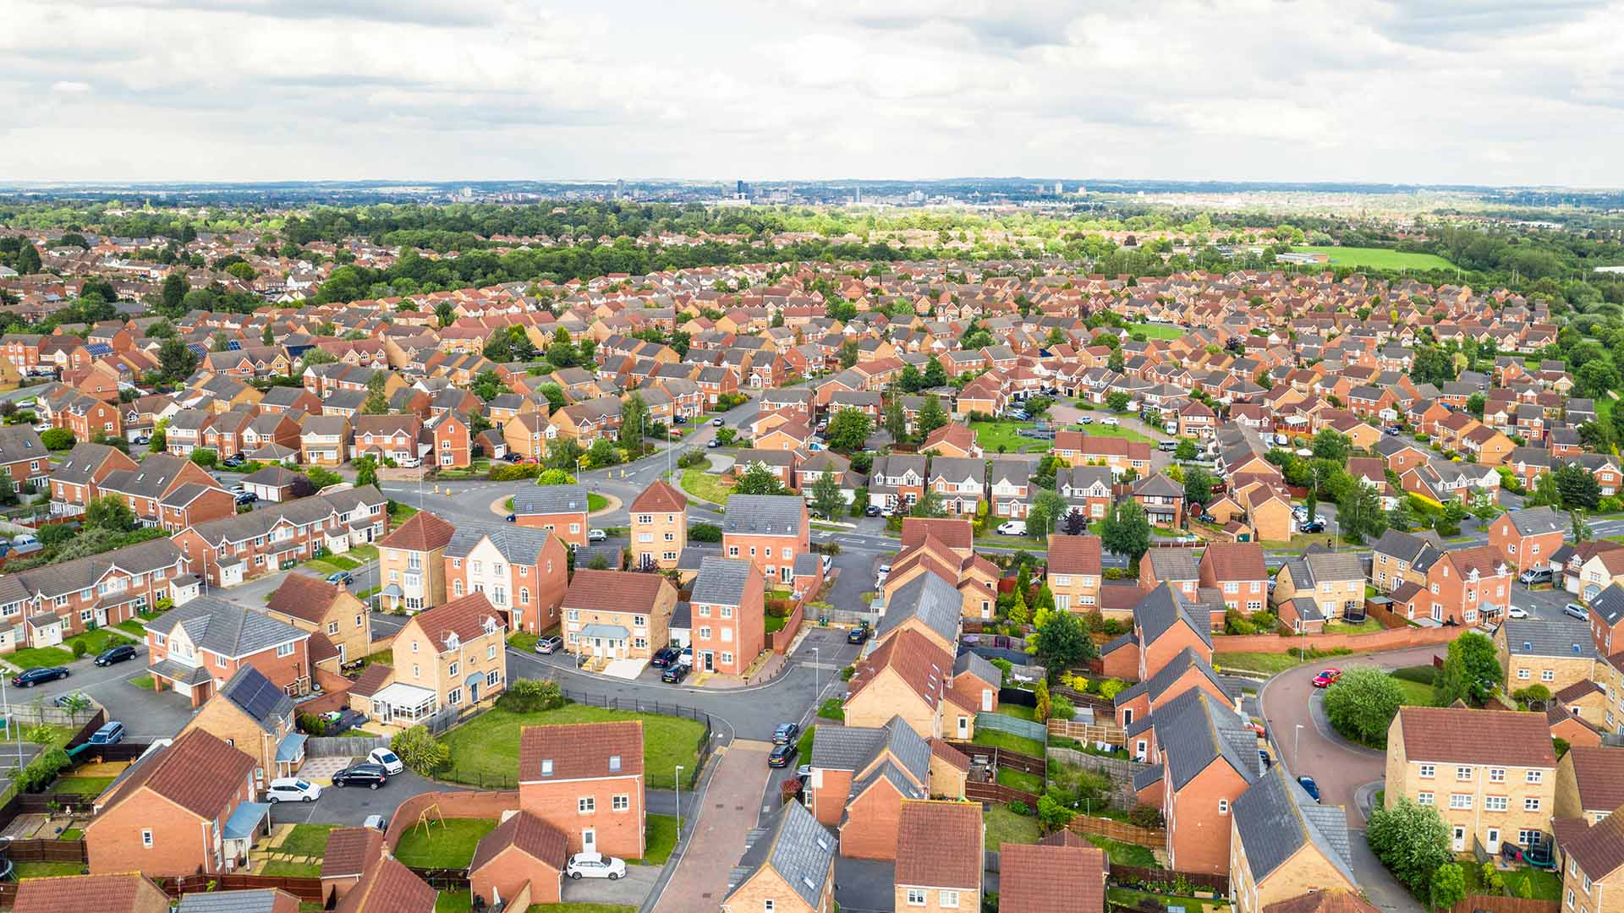
Life Cycle

Slide 6








Life Cycle
LIFE CYCLE
1. Pre Issue (Letter of Claim, Letter of Response, ADR)
8. ADR
7. Trial
2. Issue
6. Experts
3. CMC
5. Witness Statements
4. Disclosure

Slide 7

Causes of Action

Slide 8
Causes of Action
Breach of Contract
Negligence
Nuisance
Section 209 Water Industry Act 1991
Section 1 Defective Premises Act 1972
Section 2 Consumer Protection Act

Slide 9

Breach of Contract

Slide 10




Breach of Contract
What is a contract?
“an agreement with specific terms between two or more persons or entities in which there is a promise to do something in return for a valuable benefit known as consideration”
Key Elements
  Offer
  Acceptance
  Promise to Perform
  Consideration

Slide 11
Breach of Contract
Common types of contract within subrogated recoveries
Common types of breach within subrogated recoveries
Contracts for works (e.g. building or repair)
Leases (as between landlord and tenants)
Contracts for the sale of goods or services
Two types of terms that can be breached:
Specific terms (terms actually written or specified into the contract); and
Implied terms (terms implied by statute)

Slide 12
Breach of Contract
Implied Terms – Pre 1 October 2015
Business to Business contracts
Sale of Goods Act 1979
section 14 – goods supplied under the contract are of satisfactory quality having regards to fitness for purpose, safety and durability
Supply of Goods and Services Act 1982
section 4 - goods supplied under the contract are of satisfactory quality and, where the seller should know what the purpose of the goods are, they will be reasonably fit for that purpose.
section 13 - there is an implied term that the supplier will carry out the service with reasonable care and skill.

Slide 13
Breach of Contract
Implied Terms – Pre 1 October 2015
Consumer contracts
Consumer Rights Act 2015
section 9 – goods to be of satisfactory quality having regards to fitness for purpose, appearance and finish, safety and durability
section 10 - goods to be reasonably fit for purpose.
section 49 - there is an implied term that the supplier will carry out the service with reasonable care and skill.

Slide 14

Breach of Contract Example
EXAMPLE
Your Insured owns a house.
They instruct a plumber to install a new bathroom.
Nothing in writing – 'cash in hand'
A week after the bathroom has been installed, a pipe connection fails due to a poorly made joint, resulting in an escape of water.

Slide 15
Breach of Contract Example
ANSWER
Direct contract with plumber
Failure to undertake the work with reasonable skill and care
Breach caused the loss and damage

Slide 16
Breach of Contract - Defences
Common Defences / Issues
Subrogation waivers (often against tenants, and sometimes against contractors) in the Insured's policy
Joint Names Provisions – an obligation in the contract of works to insure works/existing structures in the joint names of the Insured and the contractor. Very common in JCTs.
Limits of Liability (often in contracts where one business is supplying another, and in removal/courier/storage companies). Usually these will appear in standard terms and conditions only referenced in the contract – you will have to find them online.
Limitation – 6 years from the date of the breach (12 years, if the contract is a deed).

Slide 17
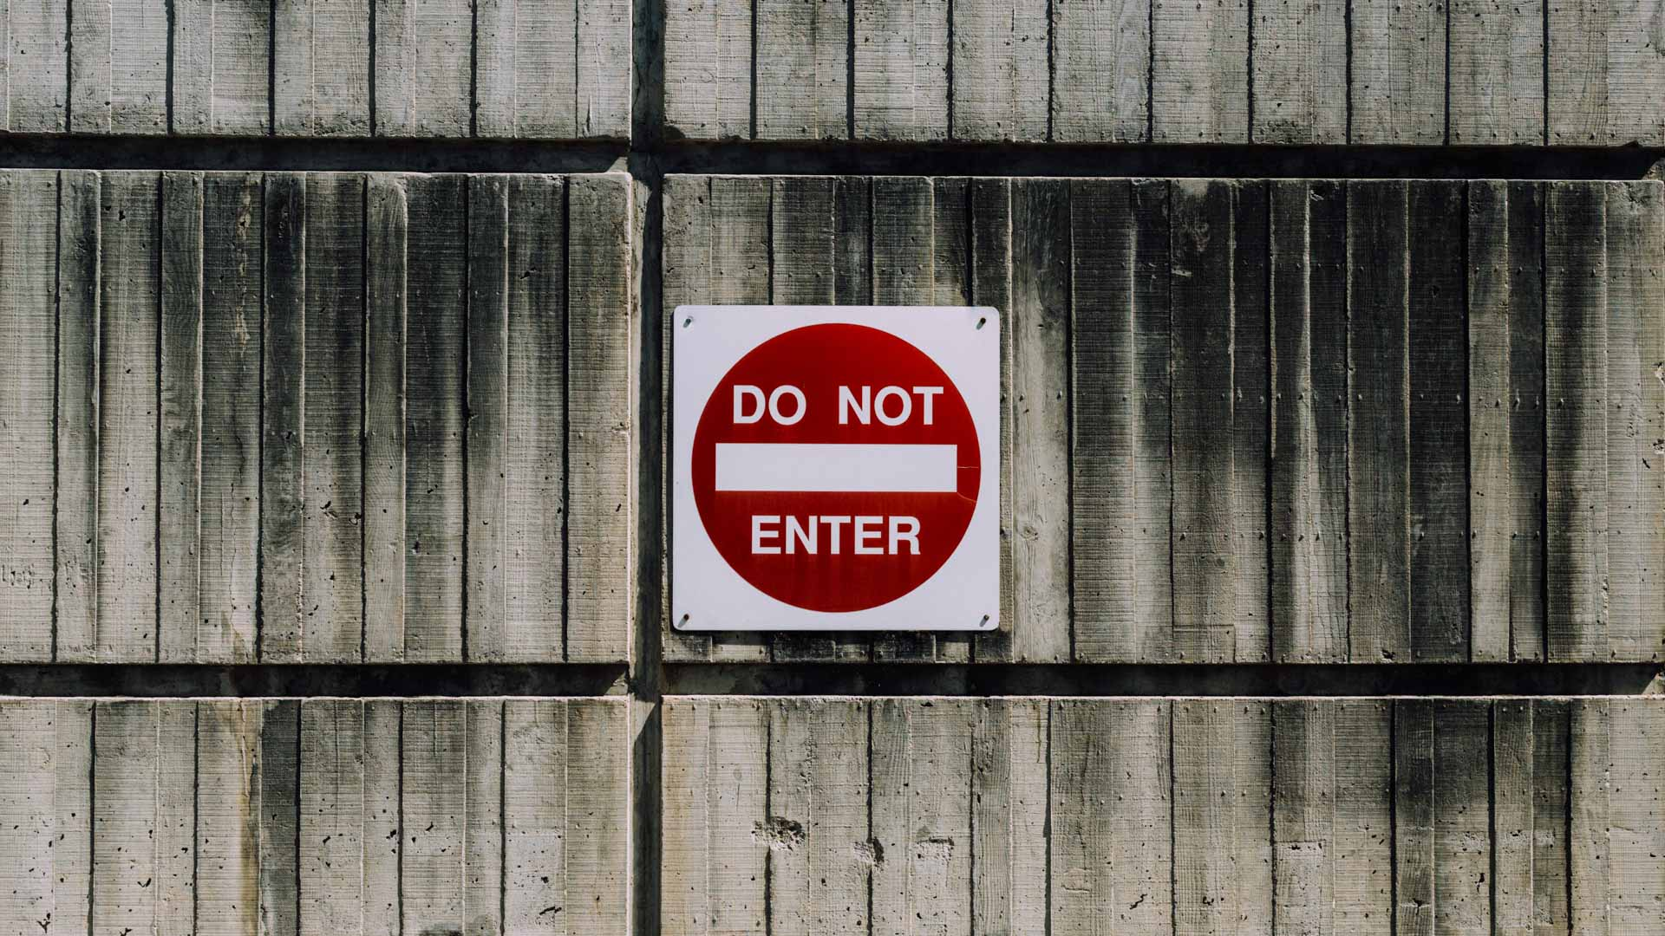
Negligence

Slide 18




Negligence
This principle of tort allows for individuals to recover damages suffered where a party has breached a duty of care to them, and that breach has led to the damages suffered.
Key Elements:
  Duty
  Breach
  Causation
  Loss

Slide 19
Negligence
Duty
Breach
Cause and Loss
Risk to the claimant by the defendant must be reasonably foreseeable
There must be a proximate relationship between the parties
It must be fair just and reasonable to impose a duty.
Can be simplified as a failure to perform an action with the reasonable level of skill and care to be expected of that person
Therefore a plumber – or anyone undertaking plumbing work – will be expected to perform their job to the standards expected of a reasonable and competent plumber
Statutes, regulations and guidance are all helpful in proving breach – for example, building regulations, health and safety guidance
The breach must have caused the damage, and there must be a loss

Slide 20
Negligence - Example
QUESTION
Your Insured owns a house, which they lease to a tenant.
With your Insured's permission, the tenant instructs and formally contracts with a plumber to install a new bathroom.
There is a subrogation waiver in your Insured's policy prohibiting any claims against the tenant.
A week after the bathroom has been installed, a pipe connection fails due to a poorly made joint, resulting in an escape of water.

Slide 21
Negligence - Example
ANSWER
No contract with a plumber, no prospects of a claim against the tenant due to waiver
However, the plumber owed a duty to your Insured as the owner, to undertake the work with the reasonable skill and care to be expected of a reasonable and competent plumber
This duty has been breached, and damage has resulted

Slide 22
Negligence - Defences
Common Defences/Issues
Independent contractor defence – a claim against a lead contractor may fail if they can show that the independent work was undertaken by one of their separate sub-contractors – even when instructed by them
Non-delegable duties (hazardous works)
BUT Balfour v Barty King – an occupier can be liable for the actions of their negligent contractor
Watch out for! H&N Emanuel v Greater London Council – occupiers liability for the escape of fire from their land caused by the negligence of their independent contractor
Limitation – 6 years from the date of the damage, with a 15 year long stop from the date the negligent act took place

Slide 23
Negligence - Defences
Common Defences / Issues
The ‘Berni Inns’ Defence - prevents a claim against a tenant where insurers have indemnified the insured landlord for loss and damage at the demised premises caused by the negligence or other fault of the tenant, typically by fire or flood. Common in most modern leases. Key indicators in the lease are:
an obligation on the landlord to insure;
an obligation on the tenant to pay or contribute to the insurance rent;
an obligation on the landlord to direct the insurance money to repairing the property;
Has the effect of making the tenant a co-insured/beneficiary under the policy, even if not named

Slide 24

Nuisance

Slide 25
Nuisance
Two types of nuisance
We are mainly concerned with Private Nuisance
      Private Nuisance
      Public Nuisance
      Private nuisance is caused by a person doing something on their own land, which they are lawfully entitled to do, but which becomes a nuisance when the consequences of their act extend to the land of their neighbour by, for example, causing physical damage.

Slide 26
Nuisance
Key elements of a Private Nuisance Claim
Duty of care – an occupier owes a general duty to a neighbouring occupier in relation to a hazard occurring on their land. They must do what it is reasonable to expect of them – although you don’t need to show carelessness
The hazard can be natural or man-made
The defendant’s knowledge of the risk is all important; the damage must be reasonably forseeable. For this reason, claims relating to one-off incidents (e.g. a flood from a lake on a defendant’s property) are far less likely to succeed than a repetitive incidents (e.g. if the defendant fails to take reasonable flood precautions, despite repeated incidents).

Slide 27
Nuisance
The Rule in Rylands v Fletcher
A type of Private Nuisance
Imposes a strict liability on a defendant for damage caused by the ‘non-natural use of their land’.
Whilst liability is strict and there is no need to prove fault, the requirements are difficult to fulfil.
(a) The thing needs to be likely to cause mischief if it escapes
(b) The use of the land to store the thing needs to be non-natural
BUT fire claims will rarely succeed under this principle; it is not the fire itself which is being stored on the land. There would need to be proof of negligence.

Slide 28

Section 209
Water Industry Act 1991

Slide 29

Section 209 Water Industry Act 1991
What does
the Act say?
“Where an escape of water, however caused, from a pipe vested in a water undertaker causes loss or damage, the undertaker shall be liable, except as otherwise provided in this section, for the loss or damage.”
It confers a strict liability on water undertakers (e.g. Thames Water)
It is no defence to show that the escape occurred because of an act of a third party or act of God; Transco v Stockport MBC
In most cases the water authorities liability ends at the point where the pipe crosses the boundary of the property.

Slide 30
Section 209 - Example
EXAMPLE
Your Insured owns a house.
A water main bursts whilst some contractors are working on it, and it floods your Insured’s property

Slide 31
Section 209 - Example
ANSWER
A water main is a “pipe vested in a water undertaker”
Strict Liability; It does not matter how the damage has occurred, as long as the issue was not caused by our Insured or their contractors
Water undertaker is liable for the damage

Slide 32
Section 209 Water Industry Act 1991
Common Defences / Issues
Generally Section 209 will only apply to water mains and not to sewers. Therefore if a sewer fails due to the failure of the water undertaker to fulfil its duties (a pure omission), there is no strict liability (Marcic v Thames Water). However, where a water undertaker has caused a failure through a negligent act, they can still be found liable in negligence.
Be prepared for a battle on quantum! Because of the strict liability under section 209, water undertakers are notoriously hard in arguing quantum to try and save money
Limitation – 6 years from the date of the damage (the statutory breach)

Slide 33
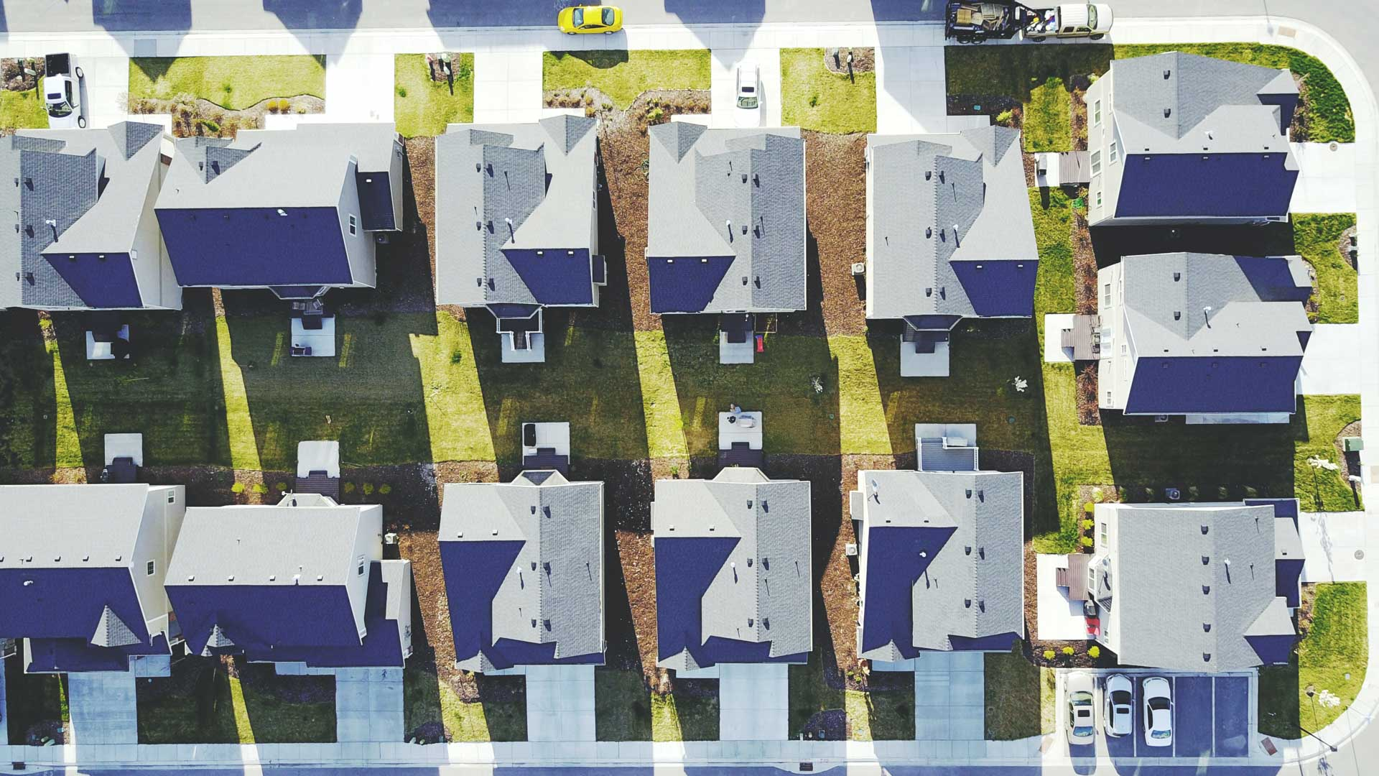
Section 1
Defective Premises Act 1972

Slide 34
Section 1 Defective Premises Act 1972
What does the Act say?
“A person taking on work for or in connection with the provision of a dwelling (whether the dwelling is provided by the erection or by the conversion or enlargement of a building) owes a duty…to see that the work which he takes on is done in a workmanlike or, as the case may be, professional manner, with proper materials and so that as regards that work the dwelling will be fit for habitation when completed.”

Slide 35




Section 1 Defective Premises Act 1972
Key elements of the Act
Duty owed to any one who ‘orders’ the build, as well as to every person who acquires an interest in the property
The duty is imposed on those who arrange construction of dwellings too (i.e. developers)
Applies to new builds, conversions and extensions
Must be ‘unfit for habitation’ as a result of the breach of duty – i.e. can the occupant live there safely and without undue convenience.

Slide 36
Section 1- Example
EXAMPLE
Your Insured buys a house.
The previous owner bought it from developers 3 years ago.
A year after your insured occupying the property, various seals on pipe joints begin to fail, causing significant water damage in the property.

Slide 37
Section 1 - Example
ANSWER
The house classifies as a dwelling
The developer classifies as a builder
It seems likely that this property is now ‘unfit for habitation’
The developer is liable for the damages suffered by your Insured

Slide 38
Section 1 Defective Premises Act 1972
Common Defences / Issues
Only applies to ‘dwellings’ – will not apply to buildings used solely for industrial or commercial purposes
Much case law on what will constitute damage which leaves the dwelling ‘unfit for habitation’ – unstable foundations, unsuitable ground to build on, no damp proofing etc are prime examples
No liability if contractor was following exact instructions; claim is against the person who gave the defective instructions
Limitation – The Building Safety Act 2022 (which came into force on 28 June 2022) amends the limitation period to bring a claim under the DPA from 6 years from the date of completion, to either:
  - 30 years from the date of completion, if the building was completed before 28 June 2022, or
  - 15 years from the date of completion, if the building was completed after 28 June 2022

Slide 39

Section 2
Consumer Protection Act 1987

Slide 40
Section 2 Consumer Protection
Act 1987
What does the Act say?
“Any:
Producer of a product
Any party who has held themselves out to be the producer of the product;
Any supplier of the product who is importing the product from outside the European Economic Area;
is liable for any damage caused wholly or partly by a defect in that product.”

Slide 41




Section 2
Consumer Protection Act 1987
Key elements of the Act
Strict liability; if the damage was caused by defect in the product, the producer is liable whether or not there is any negligence
A claim against a producer can be against the manufacturer of the finished product or just the relevant component which failed
A claim can only be made by a ‘consumer’ – i.e. an individual. Claims by companies will fail because they are not deemed to be ‘consumers’ under the act.
A product is said to have a defect "if the safety of the product is not such as persons generally are entitled to expect". In short, a product should fail safe, it should not fail by bursting into flames.

Slide 42
Section 2 - Example
EXAMPLE
Your Insured owns a house.
They install a new water cooler in the house.
After 2 years, one of the seals within the water cooler has failed, leading to a large escape of water.

Slide 43
Section 2 - Example
ANSWER
Your Insured, as an individual, is classified as a ‘consumer’
The product has a clear defect which has caused significant damage
The producer of the water cooler – or the seals, if known – is liable under the CPA.

Slide 44
Section 2 Consumer Protection Act 1987
Common Defences / Issues
As previously mentioned, this cause of action is not available to ‘non-consumers’, i.e. companies or individuals using the product for the purposes of business.
There can be difficulties identifying and locating the relevant producer on certain products
Limitation under the Consumer Protection Act is 3 years from the date of the Claimant's "knowledge", which is usually when the product exploded / leaked, subject to a 10 year long-stop from the date on which the producer put the product into circulation

Slide 45

Damages

Slide 46
Damages
What can insurers recover?
Physical Losses: Building costs/replacement contents
BUT not damage to the thing itself (Pure Economic Loss)
Financial Losses: Alternative Accommodation/Loss of Rent/Business Interruption (that are a result of physical damage OR are covered by contract)
For example, Marcus buys a new home from Shanaze PLC. Marcus sells the home to Alex 2 years later. The roof is defective. Alex’s doesn’t have a claim in contract against Shanaze PLC. Alex only has a negligence claim, but this will fail as it is pure economic loss (damage to the thing itself). But, Alex may have a claim under the DPA 1972 (see DPA example)

Slide 47
Damages
What can Insurers recover?
Physical Losses: Building costs/replacement contents
BUT not damage to the thing itself (Pure Economic Loss)
Financial Losses: Alternative Accommodation/Loss of Rent/Business Interruption (that are a result of physical damage OR are covered by contract)
For example, Marcus buys a new home from Shanaze PLC. Marcus sells the home to Alex 2 years later. The roof is defective. Alex’s doesn’t have a claim in contract against Shanaze PLC. Alex only has a negligence claim, but this will fail as it is pure economic loss (damage to the thing itself). But, Alex may have a claim under the DPA 1972 (see DPA example)

Slide 48
Damages
Betterment
Contents – most policies allow for the Insured to recover new for old from insurers. However, the rules of recovery against a third party dictate they can only recover the value of what they lost. Therefore arguments of ‘betterment’ from third parties often result in reductions (c.30%) in the claim
Buildings – Harbutt’s Plasticine v Wayne Tank & Pump confirms that betterment will not usually apply to buildings; you cannot replace a destroyed building with a second hand one.
Case law
Brit Inns Ltd & Ors v BDW Trading Ltd (and by analogy Skandia Property (UK) Ltd v Thames Water Utilities Ltd – confirms that if a sum has been assessed as reasonable by an experienced loss adjuster (as is typically the case) then the court will attach significant weight to the reasonableness of the sums paid, and it will take good evidence to demonstrate the sum was not in fact reasonable, because insurers and loss adjusters have a clear incentive to ensure the sums paid are kept to a minimum.
We typically use this argument when coming across difficult opposition and can use a Part 36 offer to prompt settlement negotiations pre-action.

Slide 49




Damages
Mitigation
What can the insured recover?
Claimant is under a duty to mitigate losses
Policy Excess
General Damages (Distress and Inconvenience) – rarely above £1,500 per year
Burden on defendant to show failure to mitigate
Uninsured losses

Slide 50
Damages
Recovering insured and uninsured losses
General rule – “pay up, recover down” Napier and Ettrick (Lord) v R F Kershaw
Insured will pay excess first, then insurers will pay their share, followed by the insured covering any uninsured losses;
In a recovery, out of the sums recovered the uninsured losses are paid first, followed by the insured losses, followed by any excess
BUT
Where there is underinsurance and an average clause has been applied, any recovery sums are split in in accordance with the average levels applied
Occasionally apportionment agreements may be necessary

Slide 51





Damages
Practical
Tips
Ensure that all payments are fully supported by documents (i.e. invoices, detailed estimates/quotations, original purchase receipts) to maximise recovery
On smaller claims >£25K tendering exercise is not usually necessary but obtain more than one quote (preferably 2/3 to show evidence of competitive pricing)
On larger claims, provide evidence of a tendering exercise
Cash payments, based on a robust tendering exercise, are still recoverable
Beware of when the third party carries out the remedial works
Retention payments often between 3-5% of works are recoverable (keep in mind if exploring settlement)

Slide 52
Damages
Uninsured Loss
RECOVER DOWN
Policy Outlay
PAY UP
Policy Excess
Pay Up and Recovery Down Model

Slide 53

Practical Tips

Slide 54
Securing the evidence early
Impact
EoW / Fire
CCTV footage/Photos
Police Report
Witnesses/statements
Identity of driver/insurer
Don’t throw it away! Appliance / Parts / Machinery (if possible, retain the exhibit yourself rather than the insured)
Documents - Contracts / Emails / Diaries / Lease
Witnesses/statements
Plumber/Fire Brigade report
When to instruct an expert? (not based on value but more on peril type - fire claims are very difficult to get off the ground without expert evidence)
Expert fixed fee arrangements (typically claims under £25K)

Slide 55
Securing the evidence early
Example
  £50K claim arising from a failed braided metal hose below a sink in the insured's property (a church).
Subsequently we were able to carry out chemical analysis that confirmed hose was manufactured from very poor quality steel.
Hose was retained by insured.
Disclosed results of analysis and third party insurers/solicitors have agreed to settle the clam (with no further liability arguments).
Failure was either due to hose being made from poor quality steel or by insured's use of abrasive cleaning products.
Probably limited chances of recovery if hose had not been retained.
Having retained the hose allowed a joint inspection with the third party expert.

Slide 56
Practical Tips
Refer to DWF's checklist for maximizing recovery potential from day one
Assess the evidence
Beware Limitation
Commence the recovery

Slide 57
Property Recoveries: Learning Outcomes
What is subrogation and how it arises in property damage claims?
Life cycle of a subrogated claim
Causes of action (Contract, Negligence, Nuisance, Statutory) and how they enable us to pursue a subrogated claim
Damages – the types of recoverable and irrecoverable loss and issues that impact recovery (betterment, mitigation, uninsured losses and pure economic loss)
Practical tips on how to maximise recoveries

Slide 58






Your team
Marcus
Chipperfield
Alex
Welch
James
Hancox
Joe
Rogers
Head of Subrogation
Senior Associate
Senior Associate
Associate
T +44 20 7220 5217
T +44 117 244 4778
T +44 117 428 9553
T +44 117 244 4779
M +44 7565 009616
M +44 7395 285145
M +44 7712 544996
M +44 7716 225795
E marcus.chipperfield@dwf.law
E alex.welch@dwf.law
E james.hancox@dwf.law
E joe.rogers@dwf.law
Lindsay
Abley
Shanaze
Mustan
Specialist Manager
Associate
T +44 117 244 4772
T +44 117 428 9514
M +44 7712 544867
M +44 7849 629243
E lindsay.abley@dwf.law
E shanaze.mustan@dwf.law

