Slide 1


Maya Whatton
13 April 2023

Slide 2
Why LinkedIn is important?
Over 800 Million members – LinkedIn is built for business, members are educated, affluent and influential
Connections, content and finding solutions
Keeps you on top of industry news, insights and clients and contact updates
Allows you to position yourself as an expert by sharing valuable knowledge
Easy to research companies, existing clients and potential clients

Slide 3
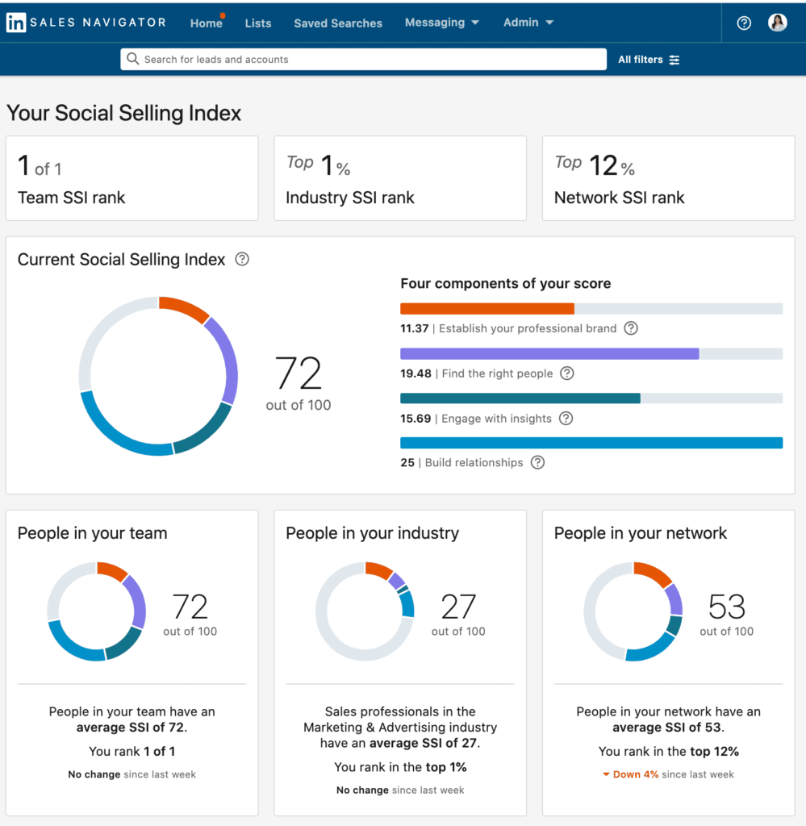
Your Social Selling Index: The 4 Pillars
Establishing your professional brand
Finding the right people
Engaging with insights
Building relationships
👉 www.linkedin.com/sales/ssi to check yours

Slide 4
Becoming more visible and credible on the network
Optimising your profile

Slide 5
Optimising your LinkedIn profile checklist
✅ Public URL
✅ Images (Profile photo, banner image)
✅ Headline
✅ About
✅ Employment (Experience)
✅ Skills
✅ Featured
✅ Honours & Awards (Accomplishments)

Slide 6
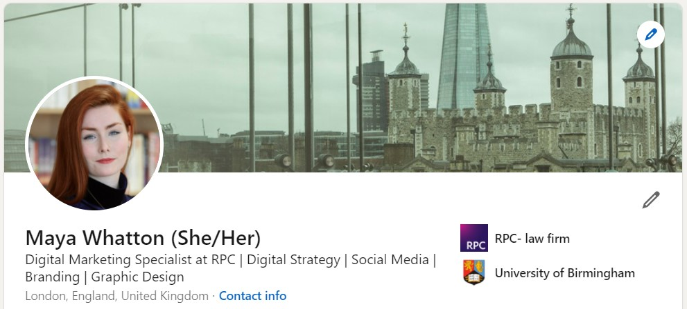

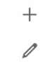

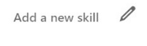
Quick tips: populate profile with relevant keywords
HEADLINE
Example Profile
Insurance Claims Examiner and Lawyer at Example Company
Use short snappy titles, you can separate them with – or | Best practice example: [Expertise] lawyer | [Sector], [Sector] | [Job title] at RPC-law firm. 120 characters max
About
Since qualifying as a solicitor in 2016 I have accumulated a range of experience across the insurance sector, specialising in high value financial lines claims, predominately focusing on handling complex FI/D&O and professional indemnity (PI) claims. […]
[…] My experience also covers Warranty & Indemnity, Investment Management and Commercial Crime within the London Insurance Market.
EXPERTISE
Can be skimmed in 30 seconds or less. Hone your first sentence, focusing on top keywords
Experience
JOB TITLE (both current and past)
Expert on all aspects of insurance claims, specialising in:
FI/D&O
Professional Indemnity (PI)
Commercial Crime
Warranty & Indemnity
Investment Management
Mentioning your team or practice is an opportunity to add keywords Include RPC – law firm. 100 characters max
Skill & endorsements
SKILLS
Insurance Law
Insurance Claims
Claims
International Insurance
Professional Liability
Dispute Resolution
Litigation
Add skills including your primary keywords at the top of the section 80 characters max
Also add a full list of your relevant skills – your connections will then be able to endorse you for these by clicking a single button

Slide 7
Creating a content strategy and staying active
Content

Slide 8
Content: The 4 Pillars
Personal Content
Goal: To strengthen relationships & approachability How? by sharing your own interests, opinions, activities and experiences on your own profile. LinkedIn = people to people
Thought Leadership Content
Goal: to demonstrate industry knowledge and grow your follower base How? by sharing blogs, podcasts, publications, white papers, reports, infographics
Event Content
Goal: To show people where they can meet you and your company in real life or virtually How? are you organising an event, webinar or attending a conference or seminar
3rd Party Content
Goal: To demonstrate industry knowledge and increase followers by informing them about latest trends/ developments How? Create Google Alerts, follow hashtags and industry experts to identify valuable content, and start curating

Slide 9
For efficiency and maximum impact
Quick tips

Slide 10
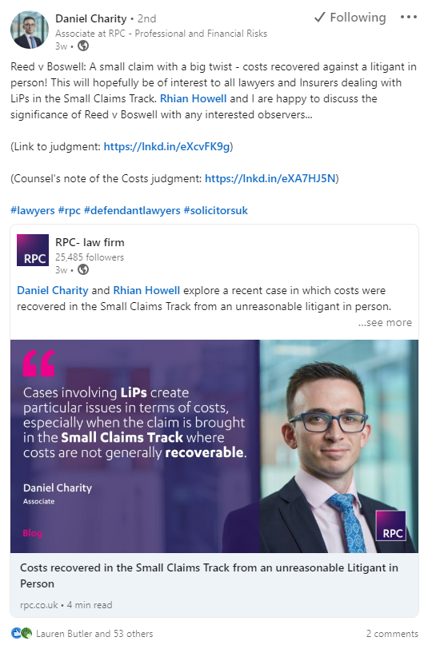
Quick tips: Writing a great post
✅ Include a trigger in the first 3 lines
get people to click “Read more” (Algorithm)
ask questions to spark curiosity
✅ Conversational tone whilst remaining professional
✅ Get creative with layout
✅ Tag any contributors using @
✅ 3-5 #Hashtags
✅ Consider a call to action
ask for questions, opinions, start a discussion
respond to any comments within 24hrs
✅ Post at strategic times

Slide 11

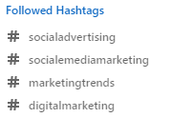
Quick tips: Follow hashtags
Choose 3 topics you want to champion, i.e. #Claims, #Insurance, and #ESG. Ideally these should match the top keywords on your profile
Use the search bar to research hashtags and their follower count, click follow
You’ll now see posts tagged with this hashtag in your news feed and a list of the hashtags you have followed on the left

Slide 12
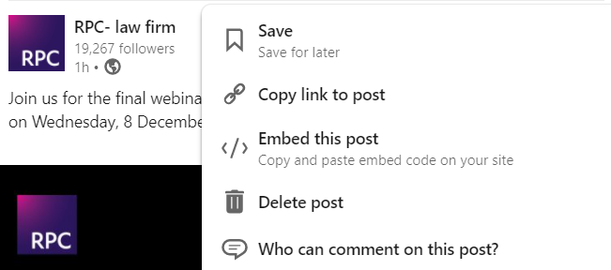
Quick tips: Staying active
It can be frustrating if you see a post and then can't find it again in your feed, build a backlog of saved items and share third party content 1-2 times a week
Use the Save function to bookmark posts in your news feed
Go to My items on the left panel of your LinkedIn homepage to access saved posts

Slide 13
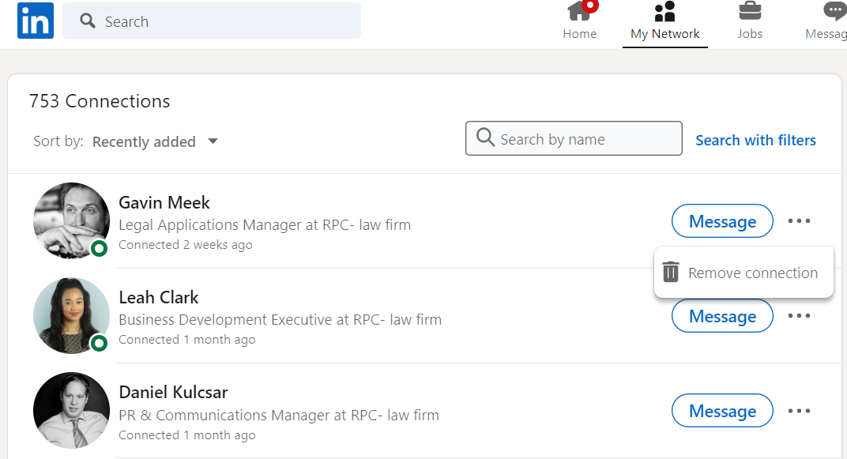
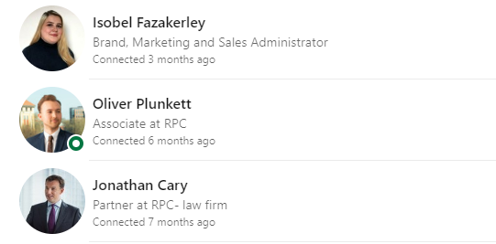
Quick tips: Unfollow contacts
Easily clean up your feed by unfollowing irrelevant contacts – they won’t know they’ve been unfollowed, and they stay as a contact

Slide 14


