Slide 1
5 Skills of a Future-Proofed Adviser in Insurance & Financial Services
Jeff Heasman MABP, PGCert CELTA, LL.B (Hons), LL.M
Certified Practitioner Member of the Academy of Modern Applied Psychology
Member of the Association for Business Psychology
linkedin.com/in/jeffheasman

Slide 2
Learning objectives
By the end of this session, participants will be able to:
identify the key skills that will ensure you are a future-proofed trusted adviser.
explain current and future trends in the markets and the way in which professional services are delivered.
implement a strategy to adapt to current and future trends to remain relevant and trusted as an adviser.

Slide 3
Market research
KPMG / LMG – The Future of Skills in the London Market, 2019
Word Economic Forum - Future of Jobs Report, May 2023
PwC – Claims Workforce of the Future 2030

Slide 4
Trends
Increased automation and use of big data.
“Smarter” and more demanding clients.
Increased use of generative AI (ChatGPT).
Reactive indemnity to proactive risk management.
Smarter pricing increasing competition to move beyond premiums.
The FCA increasingly emphasising the need to understand behavioural biases.

Slide 5
The 5 Skills
Building and maintaining trust.
Harnessing analytical and creative thinking.
Recognising and handling behavioural biases.
Understanding and adapting to the role of AI and big data.
Utilising ecosystems.

Slide 6
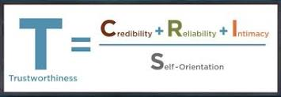
Skill 1 – building and maintaining trust
At the heart of trust is vulnerability. Trust is a psychological state, though it occurs on a rational and emotional level.
Some research from banking suggests people already trust more in automated decision-making than human.
The trust equation by David Maister in The Trusted Advisor:

Slide 7
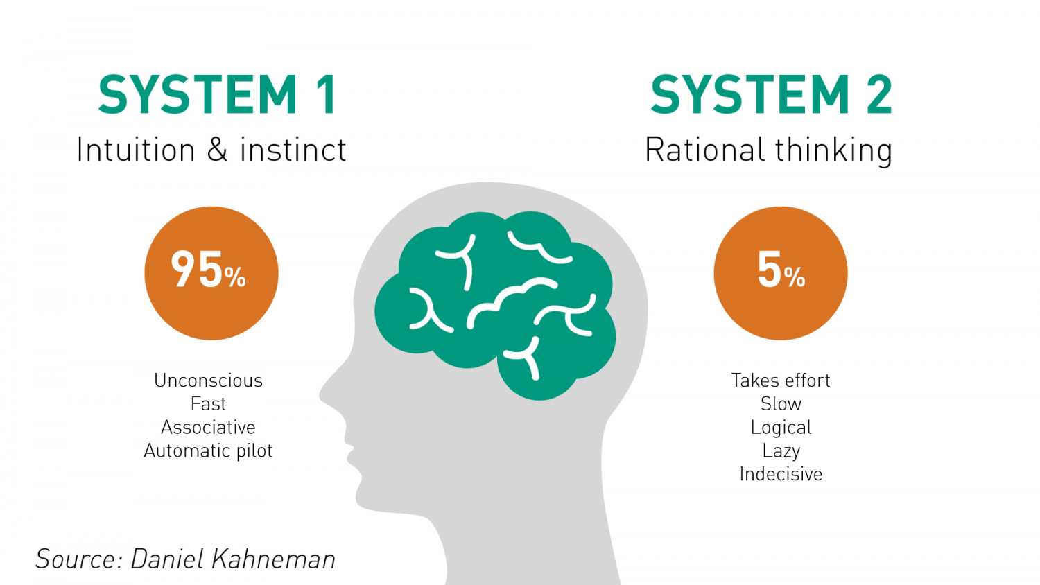
Skill 2 – harnessing analytical and creative thinking
The skill of cognitive flexibility and the pitfall of functional fixedness.

Slide 8
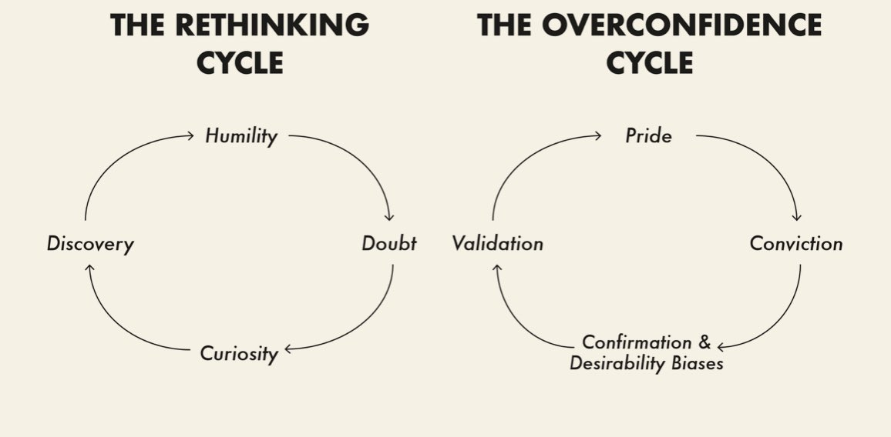
Skill 3 – recognizing and handling behavioural biases
The FCA is increasingly putting behavioural biases at the heart of regulation – the new Consumer Duty is an example.
Source: Think Again by Adam Grant

Slide 9
Some typical biases:
Confirmation bias
Sunken costs fallacy
Friction avoidance
The affection effect
The ambiguity effect
The recency and herd effect

Slide 10
Skill 4 - understanding and adapting to the role of AI and big data
Human in the loop.
Critical ignoring.
The changing role of humans in claims – see the PwC report, Claims Workforce of the Future 2030

Slide 11
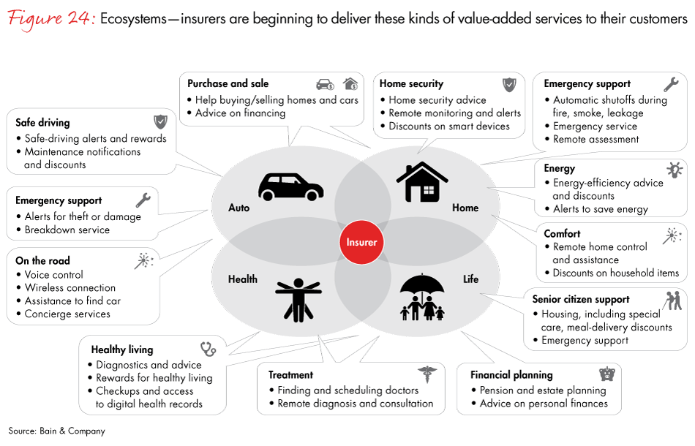
Skill 5 – utilising ecosystems
The “job to be done” theory links directly to customer expectations. Reactive indemnity will move towards proactive risk management. Ecosystems are key.

Slide 12
A reminder of the 5 Skills
Building and maintaining trust.
Harnessing analytical and creative thinking.
Recognising and handling behavioural biases.
Understanding and adapting to the role of AI and big data.
Utilising ecosystems.

Slide 13
Restatement of learning objectives
During this session, we have:
identified the key skills that will ensure you are a future-proofed trusted adviser.
explained current and future trends in the markets and the way in which professional services are delivered.
learnt how to implement a strategy to adapt to current and future trends to remain relevant and trusted as an adviser.

