Slide 1
5 Habits of Highly Effective Claims Handlers in Insurance
by
Jeff Heasman MABP, PGCert CELTA, LL.B (Hons), LL.M
Certified Practitioner Member of the Academy of Modern Applied Psychology
Member of the Association for Business Psychology
linkedin.com/in/jeffheasman

Slide 2
Learning objectives
By the end of this session, participants will be able to:
identify the 5 habits of highly effective claims handlers.
explain how these five habits impact the claims process both from the insurer and customer perspectives.
implement a strategy to be a highly effective claims handler.

Slide 3
The 5 habits
Highly effective claims handlers always:
seek disconfirmation, not confirmation;
avoid splitting the difference;
focus on solutions rather than problems;
ask more than they state; and
summarise and show how the law/policy terms apply.

Slide 4
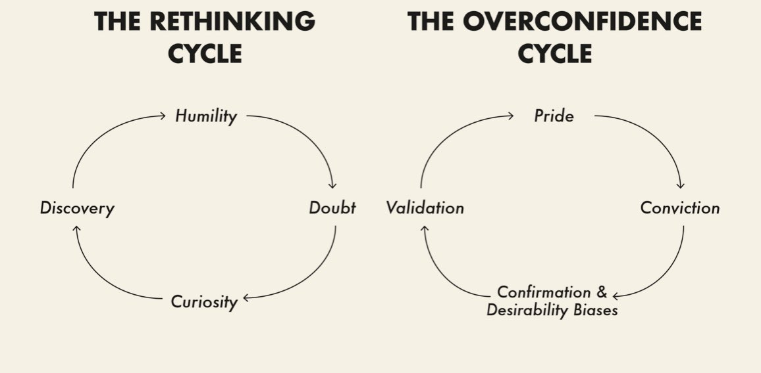
Habit 1 – seeking disconfirmation

Slide 5
The mindset. (Think Again by Adam Grant)
Functional fixedness (looking for patterns).
Self-serving bias.
Facts v stories.
Impact: assumptions are avoided and curiosity opens up new lines of enquiry. The customer/third party is more confident that you are carrying out appropriate and objective investigations.

Slide 6
Habit 2 – avoid splitting the difference
Strategies for offers avoid you getting yourself into a corner.
Interests in negotiations.
Negotiating by diminishing scale.
Impact: you are not seen as a pushover in negotiations and you don´t under-settle/over-settle

Slide 7
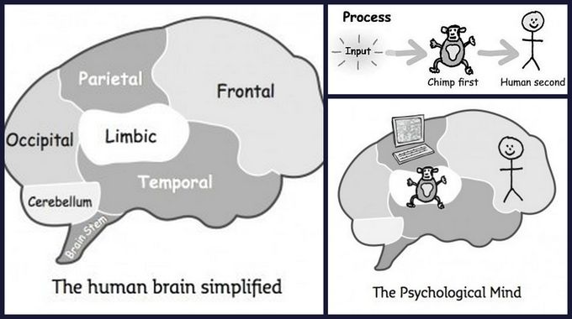
Habit 3 – focus on solutions rather than problems.

Slide 8
Focus on reality. What are they thinking and why?
Show empathy.
Impact: handling disagreements appropriately is critical in managing customer perceptions/expectations.

Slide 9
Habit 4 – ask more than you state
The “Mom” test.
Active listening + discriminative listening.
Probing style questioning v leading questions.
Impact: decisions are made on substantiated grounds and the customer/third party feels listened to.

Slide 10
Habit 5 – summarise and apply
Simplify and apply.
A highly effective method:
Claim
Law
Evaluation
Outcome
Impact: the customer / third party is able to see and understand what has been considered and how it applies to their specific situation.

Slide 11
An example – the facts
Susan is a chartered surveyor and she prepared a structural report on a property that John was interested in buying. Susan’s report concluded there was no structural issues. Based on that report, John purchased the property for £220,000. It transpired there was subsidence at the property and Susan should have highlighted this in her report. John now intends to sell the property because he doesn’t want the hassle of repairs. The revised value of the property is £130,000. John makes a claim against Susan.
Susan contacts you and asks whether John can sue her because she heard from her friend that John can’t claim for pure economic loss.
Advise Susan.

Slide 12
An example – advice using CLEO
(C) The claim by John is for pure economic loss and generally this is not recoverable in law. (L) However, the law states that where there is a special relationship (surveyor/client) and someone has relied on your professional skill and judgement to their detriment, they may be able to recover damages for pure economic loss. (E) In your case, John engaged you as a professional and he relied on your professional skill and judgement. You knew, or ought to have known, that John was relying on your advice and it was reasonable for him to do so. Unfortunately, the advice was not correct and he relied on this to his detriment. (O) The outcome is that John will be able to pursue a claim for pure economic loss and he has reasonable prospects of success.

Slide 13
The 5 habits
Highly effective claims handlers always:
seek disconfirmation, not confirmation;
avoid splitting the difference;
focus on solutions rather than problems;
ask more than they state; and
summarise and show how the law/policy terms apply.

Slide 14
Restatement of learning objectives
During this session, we have:
identified the 5 habits of highly effective claims handlers.
explained how these five habits impact the claims process both from the insurer and customer perspectives.
learnt how to implement a strategy to be a highly effective claims handler.

