Slide 1
Insurance Institute of Manchester
Flood master class
Wednesday 26 October 2016.

Slide 2
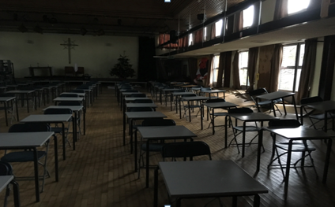
The mystery of the dry floor

Slide 3
Your presenters
Terri Adams BSc FCA
Senior Manager
Cunningham Lindsey
Forensic Advisory Services, UK
+44 792 087 1117
@ terri.adams@fas-uk.com
Peter Cragg BSc ACII FCILA
Client Relationship Director
Cunningham Lindsey
Loss Adjusting Services, UK
+44 788 078 0578
@ peter.cragg@cl-uk.com

Slide 4
Managing commercial property flood claims
We will cover:
Planning for an event and delivering it on the ground
Flooding in northern England in December 2015
Estimating a large property flood loss
Flooding as a global issue
Handling flood claims in the future
The learning objectives for today are:
Understanding how loss adjusters manage flood claims
Appreciating flooding is a global issue
Improving the customer experience
Notes:
Read the screen

Slide 5
Planning for a natural event
Assessing the need
A widespread weather event will stretch everyone
The timing and extent of it varies but the effect is very predictable – its traumatic for many people
Its always a litmus test for our industry – keeping our promises in adverse circumstances, with the world looking on
We have learnt from previous events – a good claims experience is:
- a strong bond with the Insured and the broker
- momentum through the life of the claim
- doing what you say you will do
Notes:
A widespread weather event will stretch everyone – the public, businesses, the emergency services, local government, insurers and their agents and suppliers.
An immediate response sets the scene but be ready for the long haul.
There are two main types of surge. 'National' e.g. a Big Freeze and 'local' e.g. a Flood. The following relates to a 'local' event.
There is usually some warning but it will only be a few days at most. The scale of the incident will still be difficult to estimate until the event itself is under way.
1. Primary response (immediate) - by local commercial property team
2. Secondary response (24 hours) - by Surge Response Team, adjusters and claims techs who are on permanent standby and contractually obliged to front up at any location by 9am the next day. They hold the ground whilst we get the next phase organised and this allows the local team to progress to the next stage - the office to get reports / suppliers sorted.
3. Third level response (72 hours) - large numbers of visiting adjusters from other branches. We cycle these guys through for short bursts of 3 days max so that everyone goes home with a small and manageable number of complex surge claims rather than being overwhelmed by a large volume and therefore not delivering the right focus.
4. Fourth level response (2 weeks) - if required we can pull on large numbers of ex pat adjusters from around the CL Group.
5. Fifth level response (2 weeks) - if required we can pull on our 'Surge Army' which is a relatively large group of experienced and qualified adjusters who do not currently do loss adjusting for their day jobs e.g. Trainers and auditors etc. They are already equipped and trained with up to date techniques in anticipation of any deployment.
SME – FAS for stock and BI advice so ICW strategy can be developed quickly

Slide 6
Planning for a natural event
Creating the right response
Right adjuster in the right place at the right time
Scalable resources
A clear claim plan, clearly communicated
Effective preferred suppliers
Its a long haul so be prepared
Knowing when enough’s enough
Getting the buy-in of the stakeholders
Notes:
Read the screen

Slide 7
Delivering the plan on the ground
Stages in the life of a claim
The beginning
Understanding the needs of the Insured
Building trust
Confirming cover and reducing uncertainty
Investing time and money in the Insured
Mobilising and managing other agencies
The middle
Avoiding middle age sag
Maintaining momentum
The end
Shared confidence in the outcome
Learning from the experience – feedback and planning
Notes:
Stages in the life of a claim:
The beginning:
Understanding the needs of the Insured – triage – right person, right place, right claim. VULNERABLE CUSTOMERS
Building trust
Confirming cover and reducing uncertainty. SQUEEZING THE FIRST STAGE
Investing time and money in the Insured.
Mobilising and managing the supply chain
The middle:
Avoiding the middle age sag – project managers and case reviews.
Momentum is critical, supported by effective SLAs
The end:
Providing information and shared confidence in the outcome - Optimum Settlement Time
Learning from the experience – feedback and planning
Post Visit Phase Activity
Ensuring we build on the good start we’ve made
Capacity
Maintaining capacity to deal with the possibility of further surge events
Ensuring capacity during the reinstatement phase
Cash flow
Cunningham Lindsey working capital
Building contractors
Other suppliers
Ongoing Staff Engagement
Guarding against fatigue but maintaining the momentum
Maintaining levels of communication
Client Engagement
Managing differing requirements without distracting the game plan
Maintaining levels of communication
Controlling Customers’ Own Builder

Slide 8
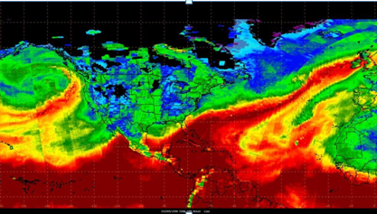
2015 – the wettest, warmest December on record
Notes:
Red is warm air – the position of the jet stream allowed air from the Caribbean to track east across the Atlantic, drawing up moisture.
Storm Desmond was an extra tropical cyclone and fourth named storm of the 2015–16 winter.

Slide 9
December 2015 – a record breaker

Slide 10
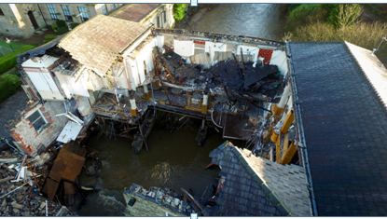
The Waterside pub at Summerseat on the River Irwell, December 2015

Slide 11
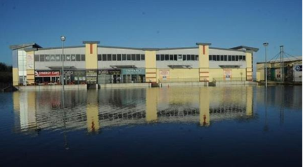
Cumbria, December 2015

Slide 12
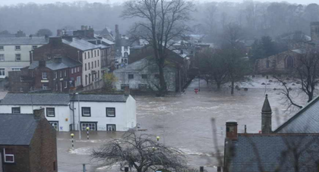
Cumbria, December 2015

Slide 13
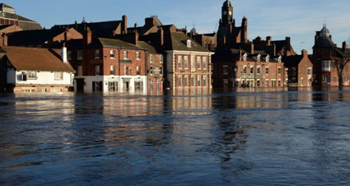
York, December 2015
Notes:
River Ouse burst its banks

Slide 14
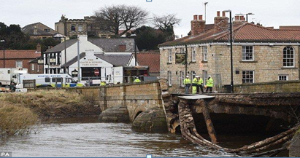
Tadcaster, Yorkshire, December 2015

Slide 15
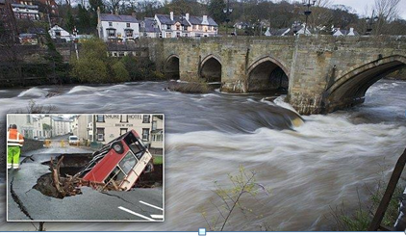
Paisley, Scotland, December 2015
Notes:
River cart burst its banks

Slide 16
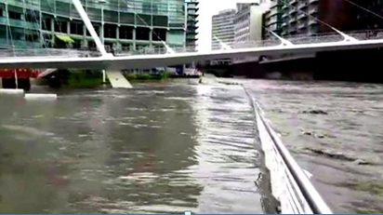
Closer to home - Manchester city centre

Slide 17
Managing commercial flood claims – the insurance industry response
ABI January 2016
15,000 claims received, including 5000 commercial claims
3,000 families in alternative accommodation
Emergency payments of nearly £24 million made to families and businesses
More than 8,300 initial visits made by loss adjusters
Total cost estimated at £1.3 billion (compared to £3.2 billion for the summer floods in 2007).
ABI June 2016
85% of properties fully or partly repaired.
85% of property claims have received a payment
£70 million paid out so far to homes and businesses

